Slide 1

Hardware System Design (Week 1) Application
March 17, 2020
Sungjoo Yoo
Computing Memory Architecture Lab.
CSE, SNU
http://cmalab.snu.ac.kr
Notes:
In this lecture, we will study what CNN is and how to implement CNN in software and hardware.

Slide 2
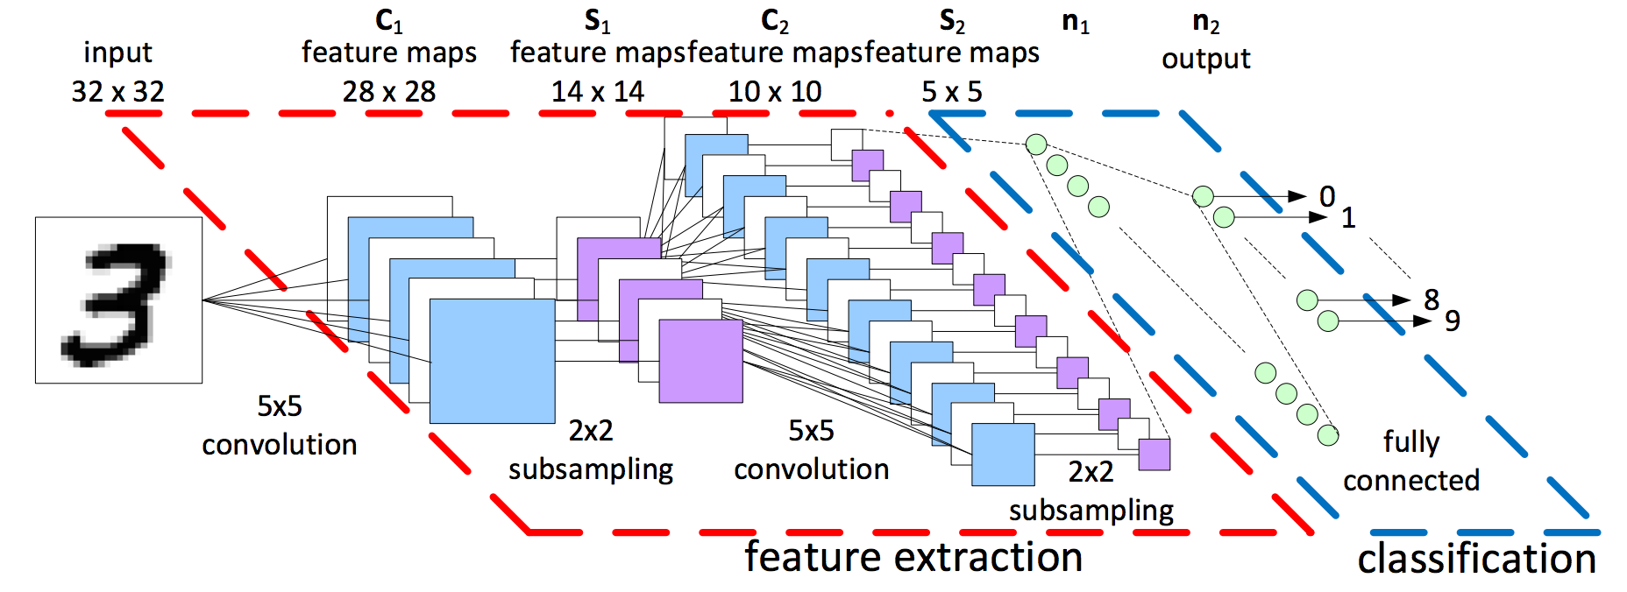
Our Application: Image Recognition Neural Network
Given an input image, the network recognizes what is in it
Notes:
(The same slide shown before)
We study hardware system design with a deep learning application, by implementing it for a software/hardware co-design.
The neural network shown here takes as input a 32 pixel by 32 pixel image and classify 10 digits as output.
The neural network typically consists of feature extraction and task-specific output layers.
In this example, the network has two convolution layers (subsampling layers in between) as feature extractor
and a single fully connected layer for the digit classification.

Slide 3
Lecture Goal: Resolving Key Questions
Fact and trend
Neural networks can outperform human in complex tasks, e.g., image classification, etc.
They will become more and more popular in mobile and embedded devices as well as servers
Questions
How can simple matrix multiplication outperform human?
How does the current hardware system run neural networks?
What does our hardware MV accelerator do for neural networks?
Notes:
We will try to resolve questions shown in this slide in this lecture.

Slide 4
Lecture Agenda
Introduction
What happens in human primary visual cortex (V1)?
Basics of neural network
Multi-layer perceptron (MLP)
Convolution
Recent hardware designs for neural networks
Google, Microsoft, NVIDIA
Our project
FPGA-based matrix multiplication for MLP and CNN
Notes:
First, we will try to understand how our brain handles visual data in primary visual cortex and how much the artificial neural network resemble the real neuron net in our brain.
We will study MLP and Convolutional neural network (CNN).
Then, we will see a few commercial dedicated hardware chip design for artificial neural networks.
Finally, we will try to understand how our CNN design consists of software and hardware components.

Slide 5
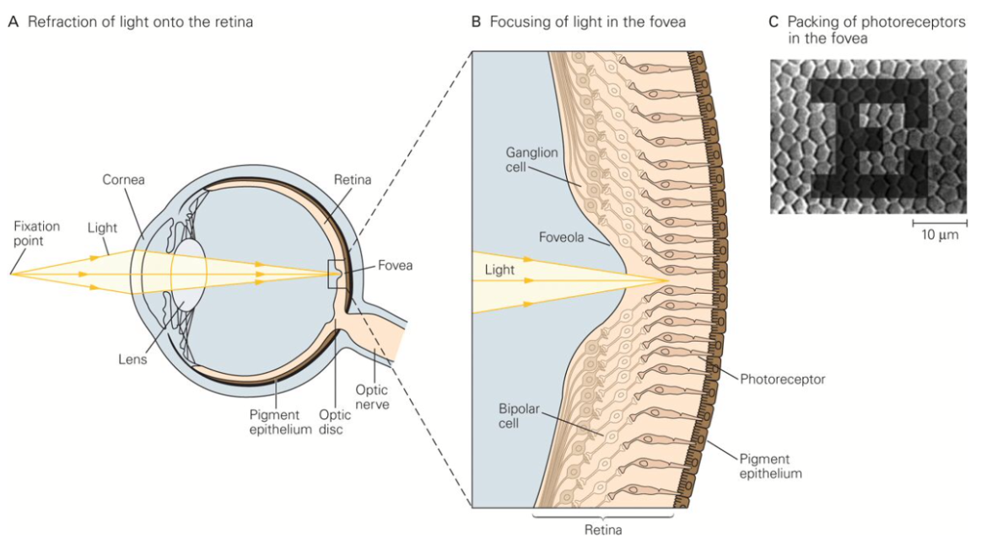
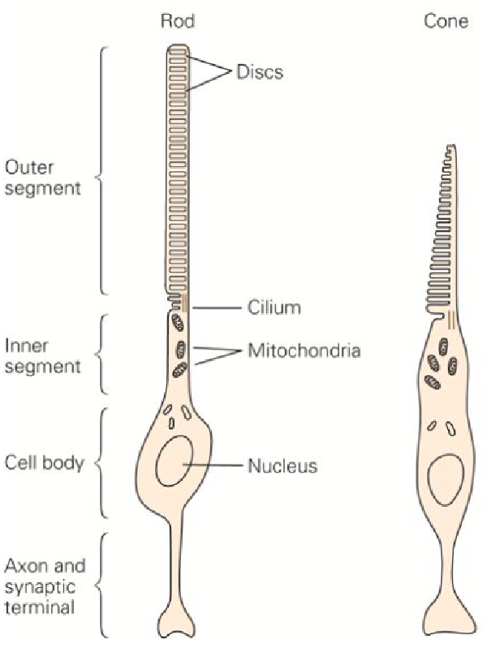
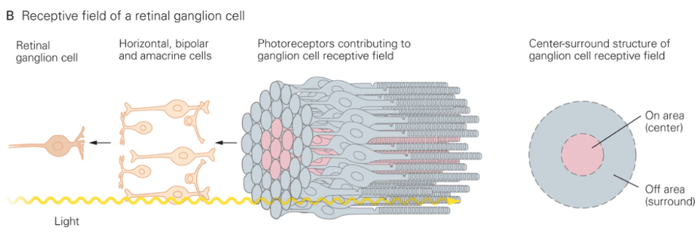
Retina: On-centered Cell ~ Image Sensor Cell
[Bear]
Notes:
The visual information, i.e., light is captured by photoreceptor cells in our retina as this slide shows.
As you know there are two types of photoreceptors, rod and cone, for brightness and color.
A group of photoreceptors are connected to a higher level cell called retinal ganglion cell as shown in the figure.
Each group of photoreceptors corresponds to an image sensor cell on our digital camera.
Thus, it detects the existence of light on its position.
The detected information (light or not) is transferred via the retinal ganglion cell to the brain.

Slide 6
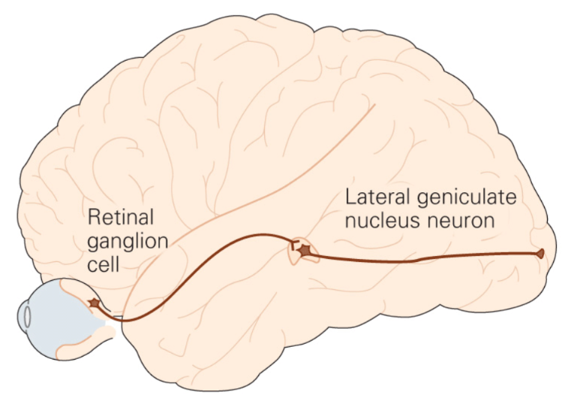
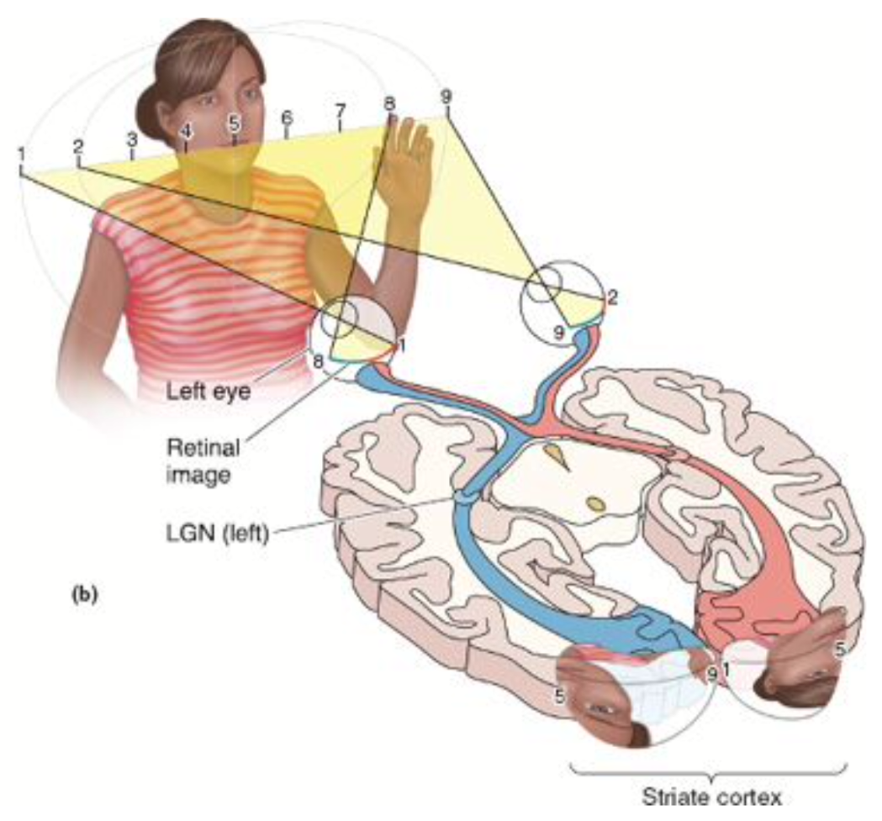
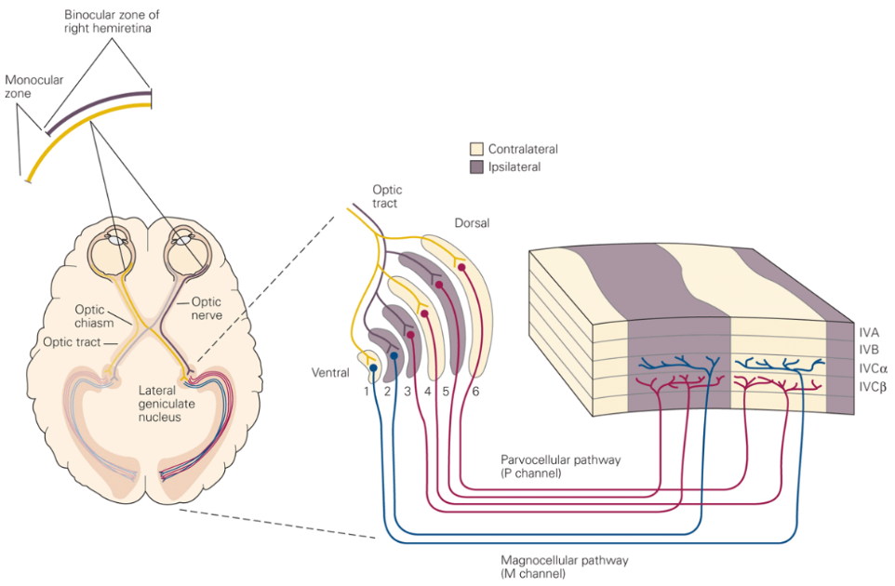
Retina → LGN → Primary Visual Cortex (V1)
[Kandel]
V1
Notes:
A retinal ganglion cell is connected, via an intermediate point called LGN, to a neuron in our brain.
As shown in the slide, the neuron which receives information from the retina is located in a region called primary visual cortex (V1), at the back of your head.
Note that a neuron in V1 represents a retinal ganglion cell in retina.

Slide 7
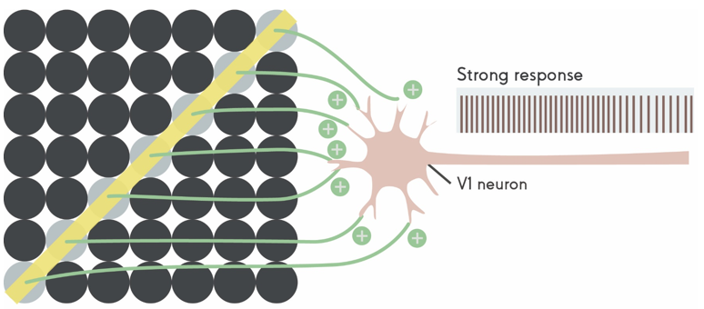
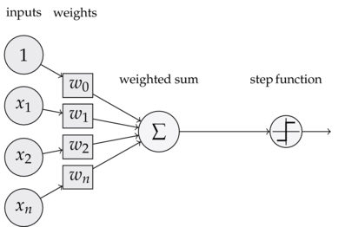
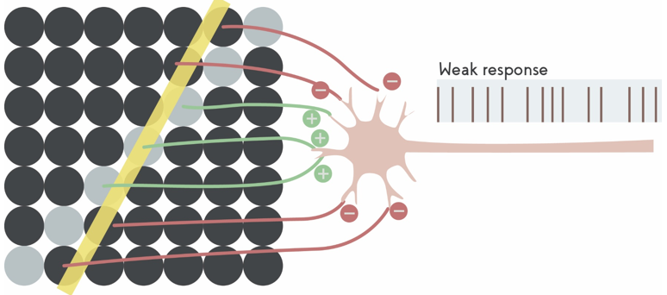
Line Detection in V1 ~ V*V Multiplication for Each Direction
[Kolb_Whishaw]
V*V multiplication
Activation function
~ local decision
Notes:
On the upper left corner of this slide, we have 7x7 array of circles.
Let’s assume that each circle corresponds to a ganglion cell.
Let’s assume that a neuron in V1 is strongly (positively) connected to the ganglion cells in the diagonal position of 7x7 array of ganglion cells.
The V1 neuron is not strongly (negatively) connected to the other ganglion cells in the 7x7 array.
In such a case, when we see a bright diagonal light in a dark room,
The ganglion cells on the diagonal position will receive light while the other ganglion cells do not receive any light.
The ganglion cells on the diagonal position will give large response, i.e., large output to the connected V1 neuron.
The V1 neuron accumulates all its inputs and produces output depending on the total amount of accumulated input.
Since the V1 neuron is positively connected with the ganglion cells on the diagonal line,
The total accumulation of input to the V1 neuron will be large enough for the V1 neuron to produce strong response, i.e., very frequent spikes as shown in the slide.
Let’s assume that the bright diagonal line changes its angle by a small amount as shown at the bottom left of the slide.
Now the same V1 neuron will receive smaller amount of input from the ganglion cell
Because the V1 neuron is strongly connected only to the ganglion cells on the diagonal position.
The input from those diagonal cells will become less since only a few diagonal ganglions receive the light while the other diagonal ganglion cells do not receive any light.
There are some ganglion cells near the diagonal ones.
However, as mentioned earlier, they are negatively connected to the V1 neuron.
Thus, if they give large output the the V1 neuron, due to the negative connectivity, the V1 neuron will receive large negative input thereby reducing its total accumulation of its inputs.
Due to the small accumulation of input, the V1 neuron will give weak response as the slide shows.
We can have an abstraction of V1 neuron behavior as shown on the right.
The abstracted behavior is a weighted sum and local decision.
Each of the inputs, which corresponds to ganglion cell outputs on the left, is multiplied by its weight of connection (between a ganglion cell and the V1 neuron).
The V1 neuron sums all the multiplications results.
Finally, based on the sum, the V1 neuron makes a decision, e.g., strong or weak response, or fire or not.
As shown on the right, the multiplications and accumulations can be modeled as vector (ganglion cells) – vector (weights) dot-product operation.
The decision of fire or not is generally called an activation function, which is considered, in general, select salient input pattern, i.e., detect a pattern in the input.
In our example on the left, the input pattern detected by the V1 neuron is a diagonal line.
Then, how can we detect a line with any angle, not only the diagonal one? See next slide.

Slide 8
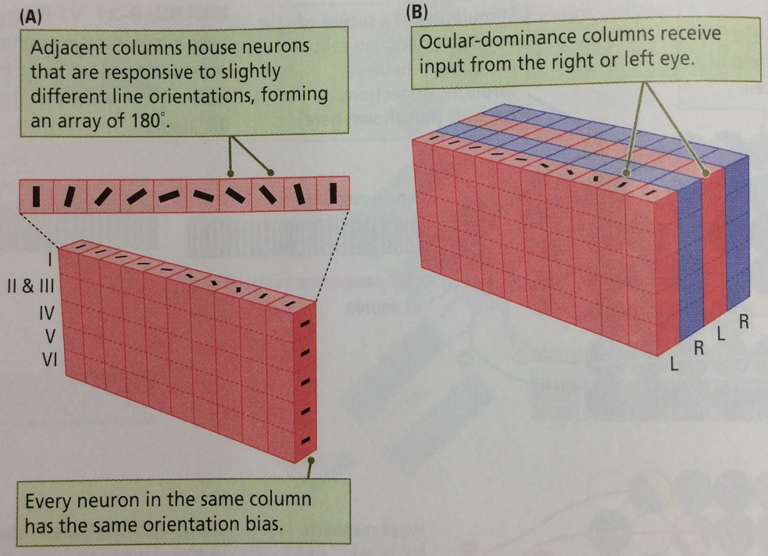
Ocular-Dominance Column for A Specific Direction: M*V Multiplication for Every Direction
[Kolb_Whishaw]
Notes:
The primary visual cortex (V1) of our brain is known to have 6 layers as shown in the right hand side of the slide.
It also turns out that the V1 neurons in the same column (of 6 layers), called ocular-dominance column, are in charge of detecting a small line segment.
The neighbor columns are in charge of detecting line segments with slightly different angles as the small line segments on the columns show in the slide.
In the previous slide, we learned that a detection of a line segment can be abstracted as a multiplication of two vectors, one input vector (from retina) and the other weight vector (representing the characteristics of connections between input and the V1 neuron).
In an artificial neural network, the set of weights is called a filter. The output of neurons (V1 neurons in our example) is called feature map.
Thus, we can consider that a feature map in the artificial neural network corresponds to the output of ocular dominance column in the real brain. In reality, the feature maps of CNN, especially, the first convolutional layer of CNN, show that primitive image features, like lines are detected by the filters of the first convolutional layer as in the V1 of our brain.
I hope you will remember that there is analogy between feature map in (the first layer of) CNN and the output of ocular dominance column in V1.

Slide 9
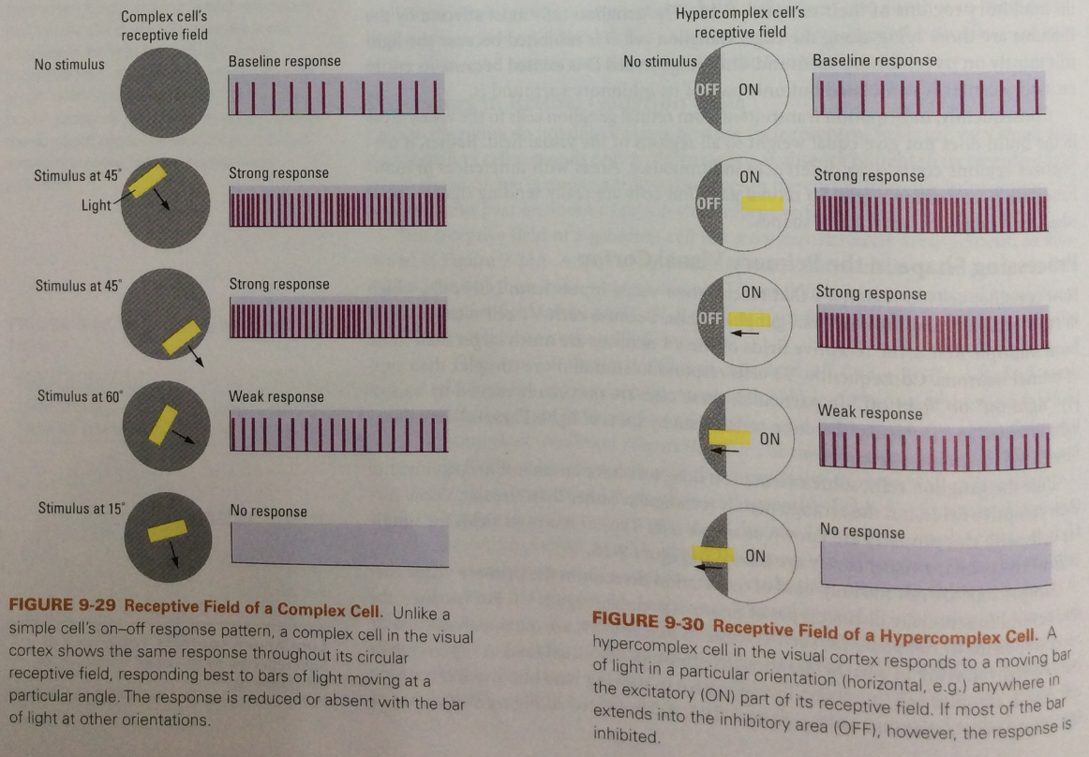
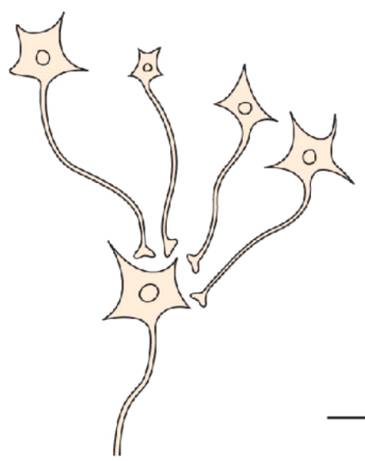
Complex Cells and Location Invariance
[Kandel]
[Kolb_Whishaw]
Notes:
In the V1 of our brain, the outputs of multiple neurons are often connected to another neuron called complex cell.
The complex cell is so sensitive that, if at least one of its input shows a fire (frequent spikes), then the complex cell also fires.
The behavior of complex cell can be modeled as a maximum operation.
Thus, the max pooling layer in the artificial neural network is analogous to the complex cell in V1.
The figures in the center of slide shows the typical behavior of complex cell.
In short, the complex cell in this example is in charge of detecting a line segment with a specific angle in a spatial region (called receptive field, circle in the example).
As the slide shows, as far as there is a diagonal line segment exists in the receptive field, the complex cell fires.
In fact, the neurons connected to the complex cell are in charge of detecting its own line segments in the receptive field.
On the left hand side of slide, there are four neurons (called simple cells detecting line segments) connected to a complex cell.
Each simple cell covers a very small region. The four simple cells will make a large region they cover, which is the receptive field of the complex cell. Thus, if any of simple cells fire (=if there is a diagonal line segment in the receptive field), the complex cell fires.
The behavior of complex cell is important in two aspects in vision.
First, it enables location invariance. The capability of complex cell that can detect a diagonal line segment in any location in the receptive field finally offers the capability that we can recognize an object wherever it is in our sight.
Second, it allows selecting salient information from the output of previous layer.
Its operation is maximum operation over multiple inputs. After the maximum, i.e., the most salient information, is selected,
the other information is discarded.
Simply put, as we approach the output of neural network, we obtain more salient information, in other words, higher level representation or feature, due to such a selection operation
In both artificial and real neural networks.

Slide 10
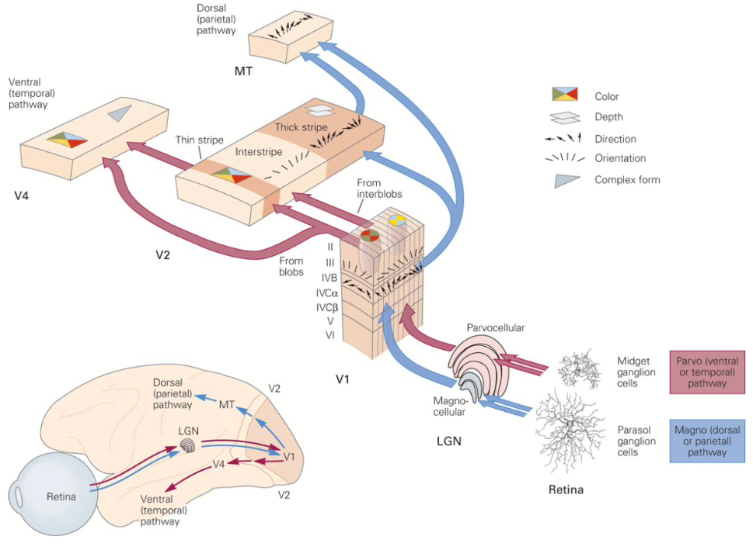
Low to High Level Feature Extraction
[Kandel]
Notes:
This slide illustrates how our brain obtain higher level representation from retina up to V4 and MT area in our brain.
Note that the highest level representation, e.g., recognition, abstract concept, …, is known to be obtained in pre-frontal cortex (near the forehead).
As the slide shows, we first obtain line segments and color in V1.
In V2 and V4, we form them to obtain shape information.
At the bottom of the slide, we can see there are two information flows originating from V1.
One goes to the temporal lobe (측두엽) where we have conscious perception on what we see.
In other words, this pathway is in charge of conscious recognition.
On the other hand, we have another pathway from V1 to the top of the head, called dorsal pathway.
The visual information in the pathway is usually used by our motion in unconscious manner.
That is why the slide shows that the information of direction (on what we see) flows on this way, which is helpful for motion control.

Slide 11
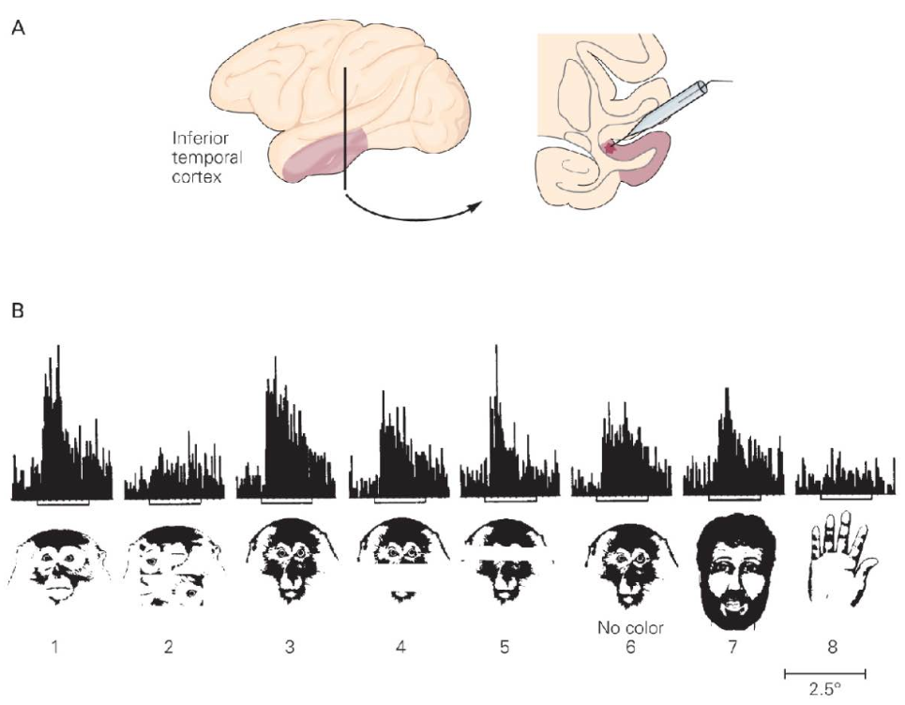
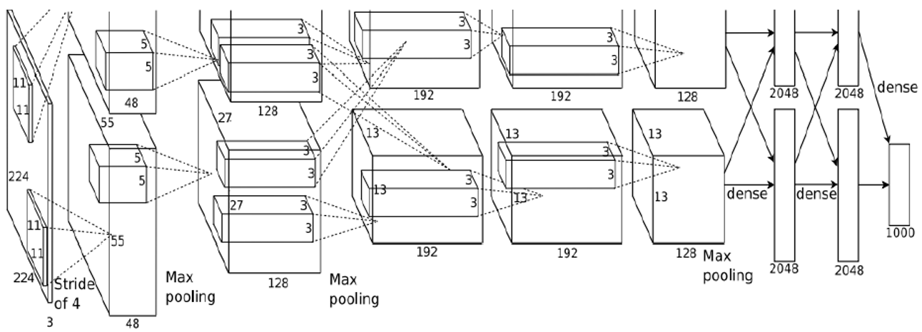
Image Classification in Brain
[Kandel]
1000
classes
Notes:
In our brain, the temporal lobe (inferior temporal (IT) cortex in the slide) is known to be responsible for object classification.
The waveforms below show the real experimental results scientists obtain in monkey experiments.
They showed the monkey pictures of monkey faces and localized a region in IT area which actively fires whenever the monkey picture is shown while the other picture, like of a hand, does not incur strong response as the slide shows.
In the case of artificial neural network, the output layer is typically in charge of outputs.
The slide shows the famous CNN called AlexNet which classifies 1000 different object classes.
It takes as input a color image (RGB) and as output gives 1000 results.
We choose the maximum output as the classification result.

Slide 12
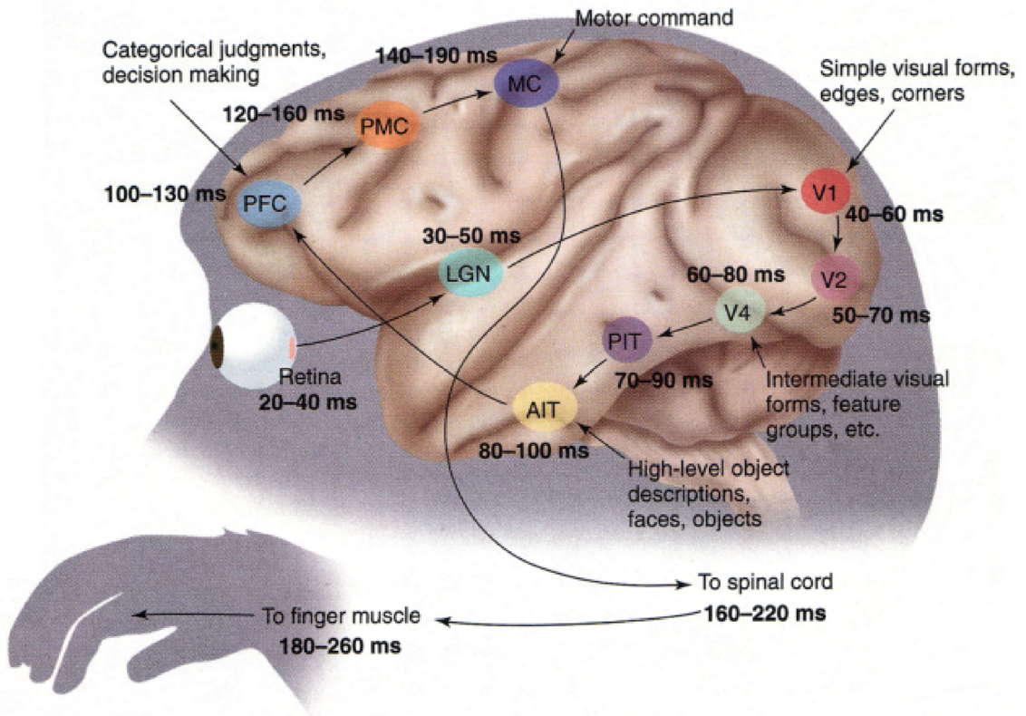
How Long Does It Take?
[Thorpe, 2001]
Optimized AlexNet
Galaxy S10 ~1ms
GPU V100 ~<100μs
Notes:
In human brain, it usually takes about 200ms to recognize a new object.
In other words, it takes about 200ms for the visual information to travel from retina, V1, IT to PFC (pre-frontal cortex).
As the slide shows there are roughly 10 synaptic connections each takes about 20ms to transmit information from one neuron to the other via chemical diffusion in synapse and electric transmission on the axon.
In the case of artificial neural network, the latency from input to output depends on which hardware platform to use.
If we run the AlexNet on Galaxy S10, it may take ~1ms while high performance GPU will execute it in less than 0.1ms.
If we compare only the latency of 1000-class classification,
the artificial neural network like AlexNet runs much faster than our real neural network.
However, its function is limited to a single task. In addition, it cannot train itself.

Slide 13
Lecture Agenda
Introduction
What happens in human primary visual cortex (V1)?
Basics of neural network
Multi-layer perceptron (MLP)
Convolution
Recent hardware designs for neural networks
Google TPU, Microsoft, NVIDIA
Our project
FPGA-based matrix multiplication for MLP and CNN
Notes:
Now, I think you have some understanding on the analogy between artificial and real neural networks.
Let’s see two representative types of artificial neural network, MLP and CNN.

Slide 14
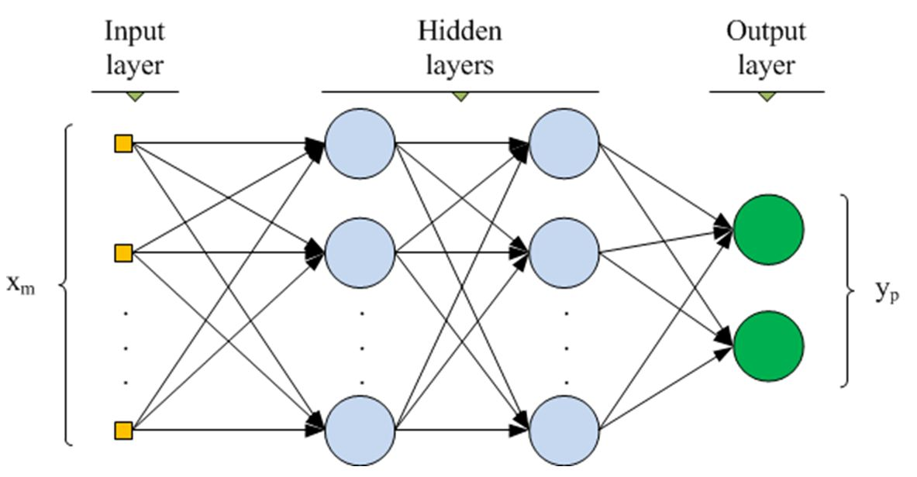
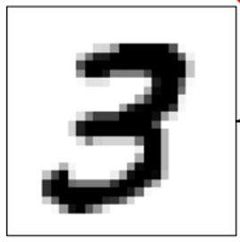
Multi-layer Perceptron (MLP)
MLP looks simpler than CNN (convolutional neural network). However, it is widely used especially in recommender system [Google ‘17][Facebook ‘20]
Output neuron tries to detect its pattern represented by its set of weights.
Thus, MLP is used to detect multiple patterns in the entire input.
Notes:
We already briefly studied MLP in the class introduction.
It has a very simple structure.
Its basic function is that, on each layer, on each output, if the input vector is similar to the weights of the output neuron,
The output neuron gives a large output value, i.e., Input vector*Weight vector, as the output.
Vector dot product is a representative metric on the similarity between two vectors.
As you know, a famous similarity metric, cosine similarity is the normalized version of dot product between two vectors.
Assume the set of weights (of an output neuron) represents the input pattern which an output neuron is trying to detect.
If you want to detect N patterns in the input, you will use N outputs (each for one pattern detection).
Actually, it gives a layer in MLP.

Slide 15
Multi-Layer Perceptron
Each layer (M inputs and N outputs) performs M multiplications between M inputs and associated weights (W) to give an output
Output[i] = Σ_{j} Input[j]*W[i,j]
Notes:
As mentioned before, MLP requires a large number of multiplications and additions.

Slide 16
An MLP Example
Input: 32x32 pixels → 1024 values
1st layer: 1024 inputs → e.g., 256 outputs ➔ Large M*V multiplication
Matrix (256x1024) x Vector (1024)
32
32
1024
256
Notes:
In this example, the first layer has 1024-dim input and 256-dim output.
Thus, we need to do 1024x256 multiplications for (weight) matrix by (input) vector multiplication.

Slide 17
Multi-Layer Perceptron
Each layer (M inputs and N outputs) performs M multiplications between M inputs and associated weights (W) to give an output
Output[i] = Σ_{j} Input[j]*W[i,j]
Output[0] = Σ_{j} Input[j]*W[0,j]
Output[1] = Σ_{j} Input[j]*W[1,j]
Output[2] = Σ_{j} Input[j]*W[2,j]
Output[N-1] = Σ_{j} Input[j]*W[N-1,j]
Notes:
This slide shows that each output of the layer is the result of vector dot product between weight vector (of the output neuron) and input vector.

Slide 18
Multi-Layer Perceptron
Each layer (M inputs and N outputs) performs M multiplications between M inputs and associated weights (W) to give an output
Each layer performs M*V multiplication to give N outputs
Output[0] = Σ_{j} Input[j]*W[0,j]
W[0][0]
W[0][1]
W[0][2]
W[0][M-1]
Input[0]
Output[1] = Σ_{j} Input[j]*W[1,j]
W[1][0]
W[1][1]
W[1][2]
W[1][M-1]
Input[1]
Output[2] = Σ_{j} Input[j]*W[2,j]
W[2][0]
W[2][1]
W[2][2]
W[2][M-1]
Input[2]
Output[N-1] = Σ_{j} Input[j]*W[N-1,j]
W[N-1][0]
W[N-1][M-1]
Input[M-1]
Notes:
The layer computation is represented by weight matrix by input vector multiplication as this slide shows.

Slide 19
What does Each Neuron Do?
Each neuron applies an activation function to the result of V*V multiplication
Output[i] = Activation(Σ_{j} Input[j]*W[i,j])
Notes:
After obtaining the dot product result, each neuron performs an additional operation called activation.

Slide 20
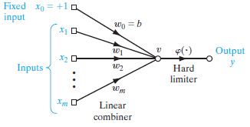
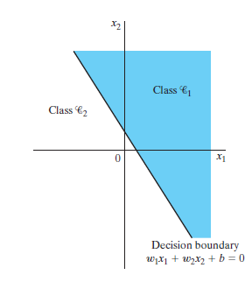
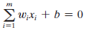
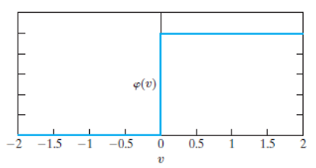
An Activation: Step Function for Binary Classification → Accept or Reject (for a Feature)
Assume a step function as the activation function
Notes:
A simple activation is a binary classification as this slide shows at the bottom.
In general, we add a term called bias to the result of dot product as the left-hand side of the equation in the middle shows.
The binary classification will be determined by the sign (positive or negative) of the result (bias + dot product result).
The equation in the middle shows a decision line.
The figure on the right exemplifies binary classification for two classes.
The equation represents the decision line, the solid line between two regions of two classes.
In this example, we assume the case that there are only two weights, i.e., two input neurons.
In general, the equation gives a decision plane in a multi-dimensional space.

Slide 21
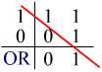
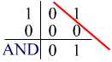
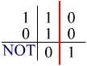
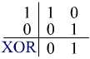
Binary Classifier
Assume a step function is used
XOR problem cannot be resolved
by a single linear binary classifier!
Notes:
Binary classifier is useful when data (i.e., features) are well grouped as we can see at the bottom of the slide
for OR, AND, and NOT patterns.
However, when data structure is complex like XOR pattern in the slide,
A simple binary classification, or a single neuron does not give satisfactory classification or selection of salient feature.

Slide 22
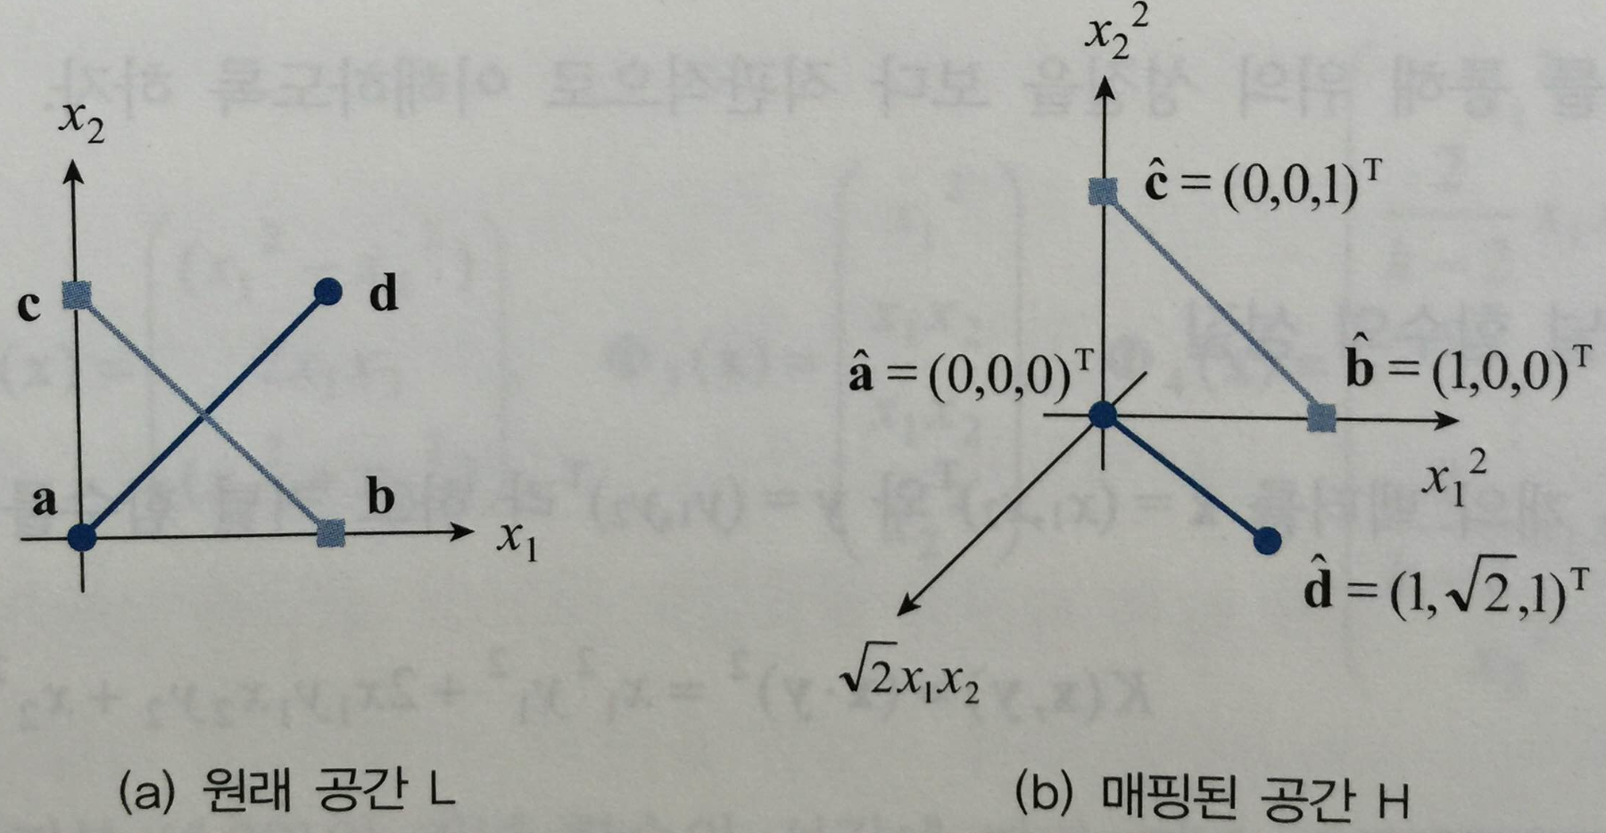
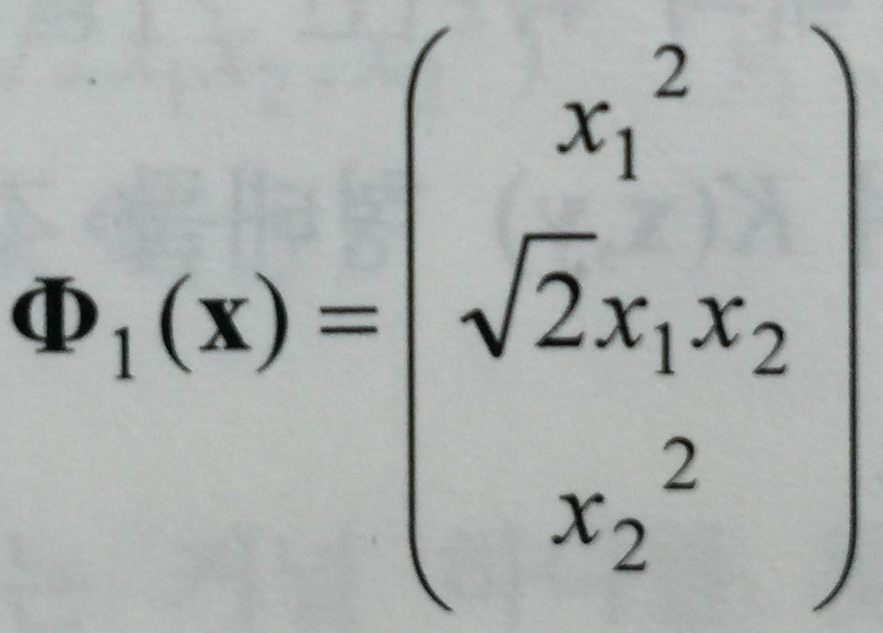
Multiple Layers for Higher Order Function
[패턴인식, 오일석]
Non-linear function
due to step functions
and biases!
Y₁
X₁
w₁
X₁
w₁
Y₂
w₅
w₂
w₂
w₆
Z₁
X₂
Y₁=step(w₁X₁+w₁₂X₂)
w₁X₁+w₁₂X₂ >=0 or not
w₃
X₂
Y₃
w₇
w₄
Non-linear transformation example
Weights determine the non-linear function.
How to obtain such weights? Training!
Notes:
In such a case, we often use more layers of neurons.
As the slide shows, by using more layers, we can use more weights and neurons.
In other words, we can handle higher dimension data.
If we can transform the previous low dimension data (like the 2-D one on the left)
to a higher dimension one (like the 3-D one in the middle),
We can easily separate the two groups of data with a 2-D plane between them,
Which means the activation function of neuron can separate them with its activation function.
It is important to obtain better representation (to do binary classification in this example).
In this example, we used the non-linear transformation function shown on the bottom right.
In the artificial neural network, we do not use such a fixed or closed form function.
Instead, we train the weights of additional layers to obtain better representation.

Slide 23
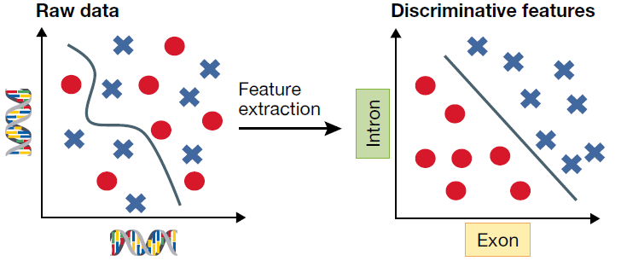
Better Representation in Deeper Networks
[C. Angermueller, 2016]
More layers give potential of better representation for our tasks, e.g., classification
Notes:
A well-trained good network gives better representation.
In this slide, the representation on the left does not look good because a simple decision line may not work for binary classification.
On the contrary, that on the right looks good.
In order to obtain better representation, we may need more layers (for more transformation) and better training methods (because deeper layers are more difficult to train).

Slide 24
Lecture Agenda
Introduction
What happens in human primary visual cortex (V1)?
Basics of neural network
Multi-layer perceptron (MLP)
Convolution
Recent hardware designs for neural networks
Google TPU, Microsoft, NVIDIA
Our project
FPGA-based matrix multiplication for MLP and CNN

Slide 25
Line Detection in V1 ~ V*V Multiplication on a Small Region = Convolution
[Kolb_Whishaw]
V*V multiplication
Activation function
~ local decision
Notes:
The line detection example we saw previously can be modeled as a pattern detection by vector dot product and activation function.
If we consider that the 7x7 input in this example belongs to a large 2D input, and we do pattern detection continuously by shifting the 7x7 window over the entire 2D image, the operation is called Convolution.
That is, the convolution on 2D input is to scanning the 2D input to detect small patterns (of 7x7 size in our example).

Slide 26
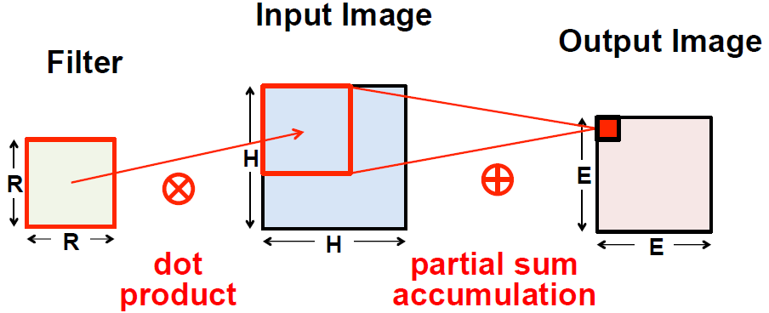
Convolution: 2D Input Case
[Chen, 2016]
Notes:
This slide shows how convolution works on 2D input.
We have 2D input in the middle (Input Image).
We have a small RxR window having weights (called filter) on the left.
In our previous example, we had R=7.
As the middle figure shows, we first place the RxR window on the upper left corner of the 2D input.
There, we do pattern detection, i.e., dot product operation between the RxR weights of filter and RxR input data in the RxR window.
The result of dot product becomes the first output neuron (small red square) in the 2D output (Output Image).
The region of the filter window is called the receptive field of the corresponding output neuron.
Then, we move the window by a certain amount (called stride, typically 1) to the right on the 2D input image.
We do another pattern detection, i.e., dot product operation to obtain the next output neuron (the neighbor of the first output neuron) on the 2D output.
In this way, we scan the RxR window across the 2D input data and finally obtain a 2D output data, called output feature map or channel.

Slide 27
Convolutional Neural Network (CNN)
LeNet (1989)
Consists of convolution layer and subsampling (max-pooling) layer
Training: backpropagation
Notes:
Typically, as this example shows, a convolutional layer takes as input 3D input called tensor and produces as output another 3D output.

Slide 28
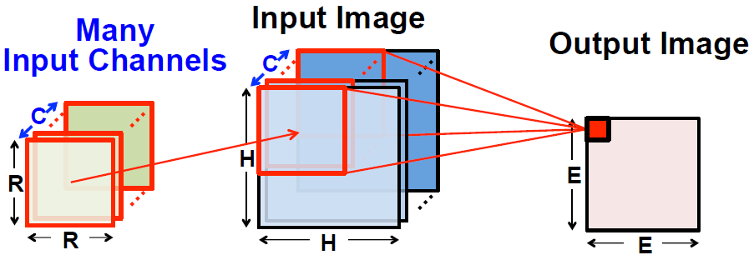
Convolution: 3D Input Case
[Chen, 2016]
A receptive field in input feature maps gives an output neuron
Each output feature map has its own set of kernel weights
Input feature maps
Output feature map
Notes:
This slide shows a typical convolution for 3D input and 3D output.
In this slide, we see only an output feature map.
Typically we have multiple output feature maps.
In this slide, each output feature map has its own set of kernel weights of RxRxC.
Note that we have 3D kernel because the input data are 3D.
As in the case of 2D convolution, we first place the kernel on the upper left corner of the 3D input as the slide shows.
Then, we do dot product operation between the kernel weights of RxRxC and the corresponding input data in the receptive field.
The result of dot product becomes the value of output neuron.
Then, we move the 3D window by a stride and do another dot production operation obtain the next output neuron.

Slide 29
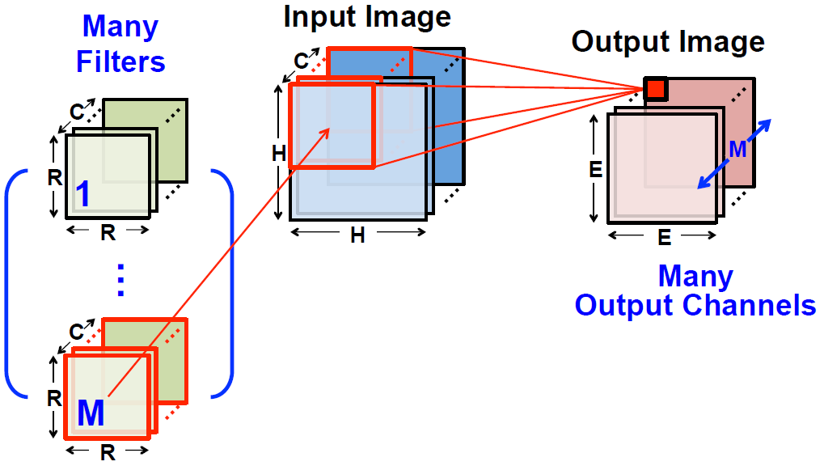
Convolution: 3D Input / 3D Output
[Chen, 2016]
Training (backprop) determines kernel weights
Notes:
This is a complete example of convolution with 3D input and output.
As the slide shows, we have M different sets of kernel weights because each output channel has its own set of kernel weights
And we have M output channels in this example.
Thus, in order to obtain an output channel, we use its associated kernel weights in convolution.

Slide 30
Convolution Example
http://cs231n.github.io/convolutional-networks/
Input 7x7x3
Output 3x3x2
Two kernels (=2 output feature maps)
Stride 2
Notes:
You can find more details of CNN operation in this URL.

Slide 31
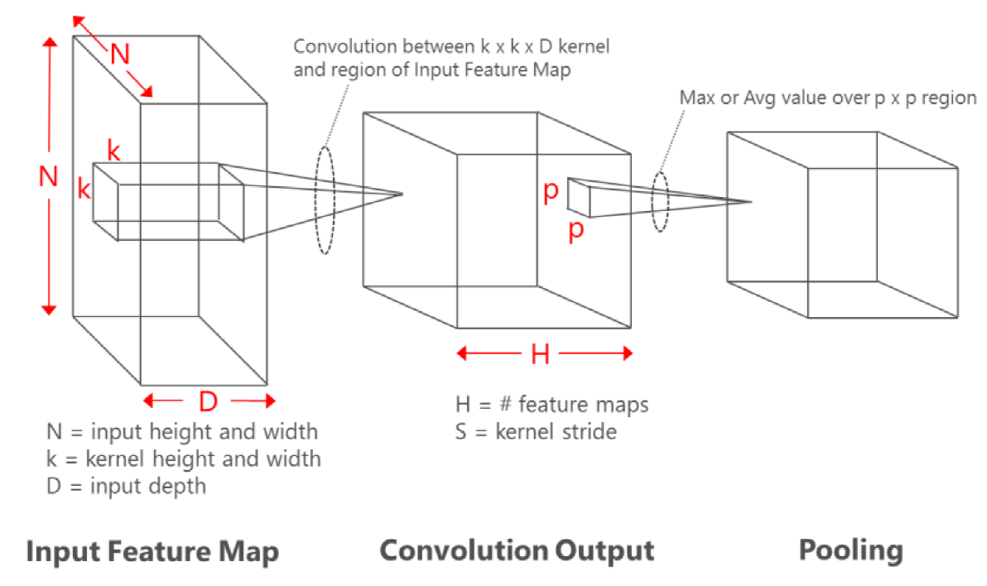
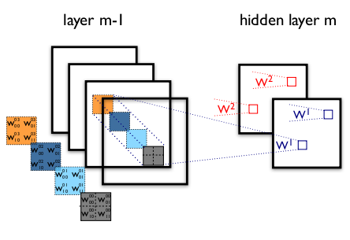
Feature Map in 1st Convolutional Layer is Similar to Ocular-Dominance Column in V1
[Kolb_Whishaw]
Notes:
As I mentioned earlier, the feature map of the first convolutional layer is analogous to the output of the ocular dominance column in V1.
A feature map in CNN can be a result of detecting a diagonal line on the entire input image.

Slide 32
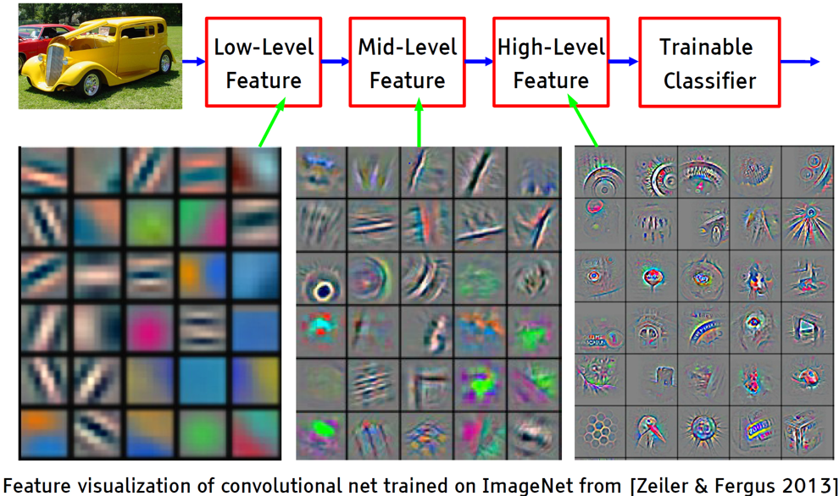
Low Level to High Level Features
[LeCun]
Notes:
As we go through the layers from the input to the output,
the CNN gives higher and higher level representation, i.e., features.

Slide 33
Convolution: 3D Input / 3D Output
[Chen, 2016]
Training (backprop) determines kernel weights
Notes:
Let’s see how we implement the convolution with 3D input and output.

Slide 34
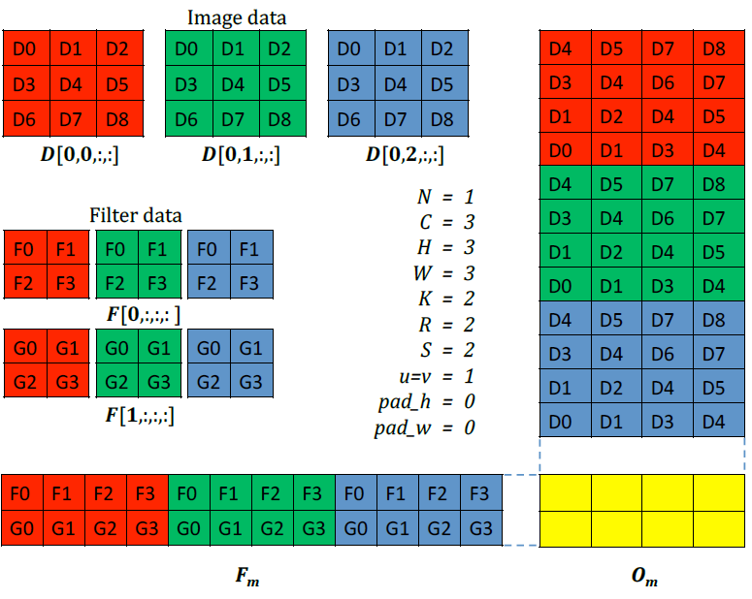
Convolution with Matrix Multiplication (called Convolution Lowering)
[Chetlur 2014]
3: vertical dimension
Input: 3x3x3
Output: 2x2x2
Convolutional kernel: 3x2x2
2
3
2
3
2
2
2
3
2
2
2x2
2
Notes:
We often flatten the 3D input and 3D kernel into two dimensional form as this slide exemplifies.
After obtaining 2D versions, i.e., input and weight matrices of 3D input and 3D kernel,
We multiply the two matrices to obtain the output matrix, which is the 3D output flattened in 2D.
Converting convolution to matrix multiplication is called convolution lowering.
In most of CPU and GPU implementations of convolution, we use convolution lowering
mainly because we can exploit well-optimized matrix multiplication library, e.g., GEMM for this.

Slide 35
Convolution on GPU
cuBLAS
Matrix-Matrix multiplication (GEMM)
Problem in data duplication of input
Matrix-Vector multiplication (GEMV)
cuDNN
V4
Focuses on avoiding duplication of input data in main memory
V5
Winograd convolution is added especially for 3x3 convolution
Notes:
Though convolution lowering is easy to utilize,
it has a critical problem of data duplication.
In this example, as the slide shows, the same data appear multiple times in the input matrix after 3D to 2D conversion.
For instance, D4 (red) appears four times in the input matrix.
The number of appearance, i.e., the amount of duplication is determined by the kernel size, RxR.
In case of large kernel like 7x7, a single input is duplicated 49 times, which means the input matrix is 49 times larger than the original 3D input, which is not desirable for performance.
The large input matrix incurs frequent cache misses in CPU and GPU thereby degrading performance.
There are a few solutions to address the data duplication problem like cuDNN from NVIDIA.
We will revisit this issue in more detail when we implement convolution lowering in our lab after mid-term exam.

Slide 36
Lecture Agenda
Introduction
What happens in human primary visual cortex (V1)?
Basics of neural network
Multi-layer perceptron (MLP)
Convolution
Recent hardware designs for neural networks
Google, Microsoft, NVIDIA
Our project
FPGA-based matrix multiplication for MLP and CNN
Notes:
Neural networks dominate server and mobile systems. Thus, many companies are developing their own dedicated hardware (chips) for neural network execution.

Slide 37
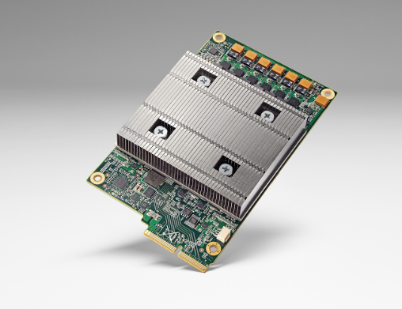
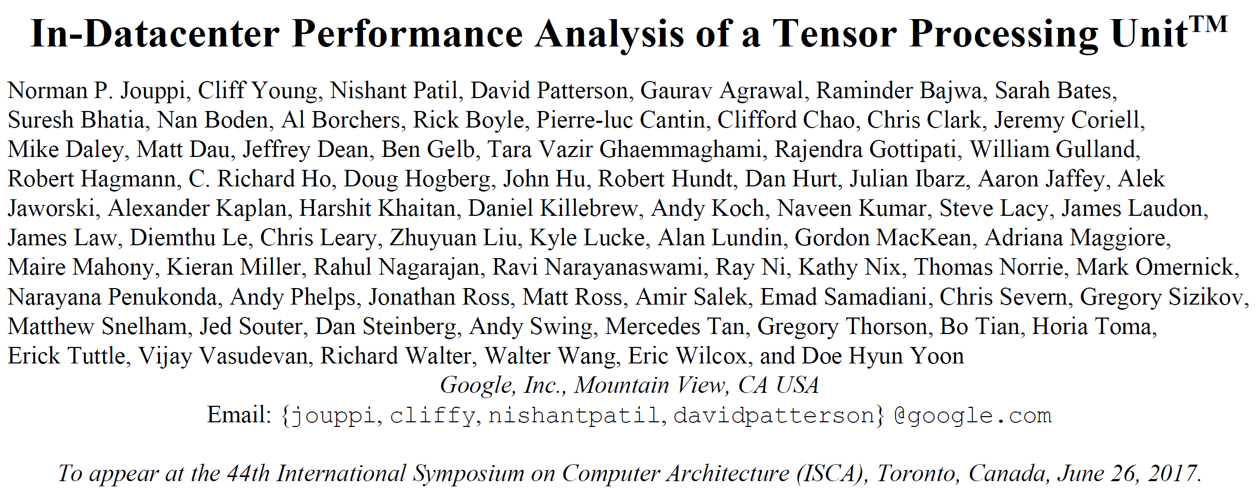
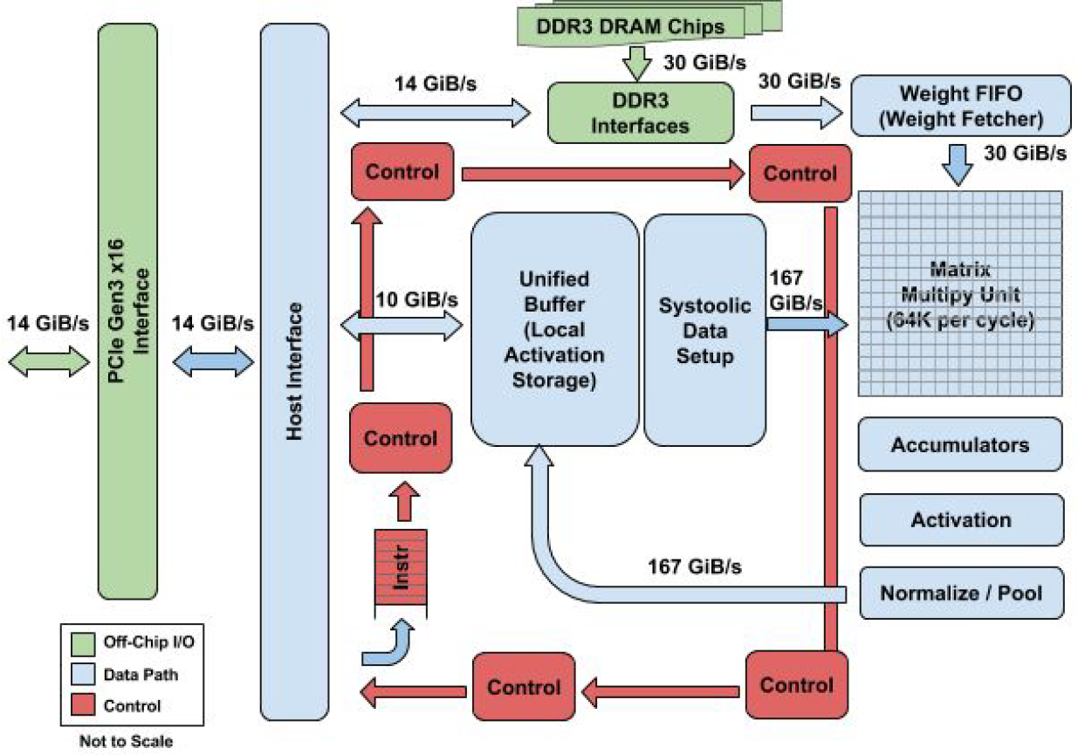
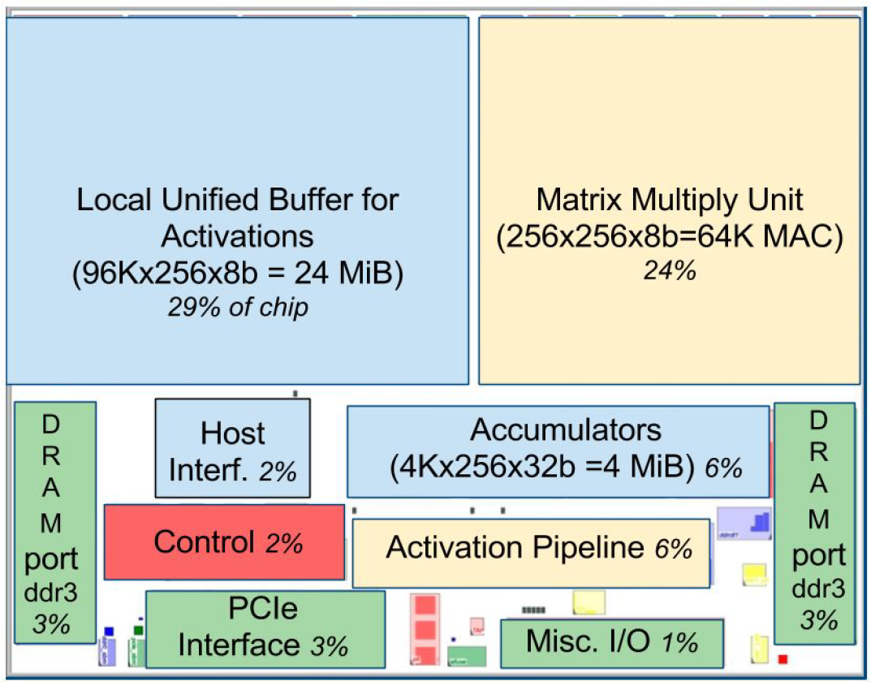
Google TPU (ISCA 2017)
Notes:
Google is one of the first companies which developed its own silicon chips only for neural network execution.
Their chips are called TPU, Tensor Processing Unit.
It also became famous after being used by AlphaGo of DeepMind in the Go game against Lee Sedol.

Slide 38
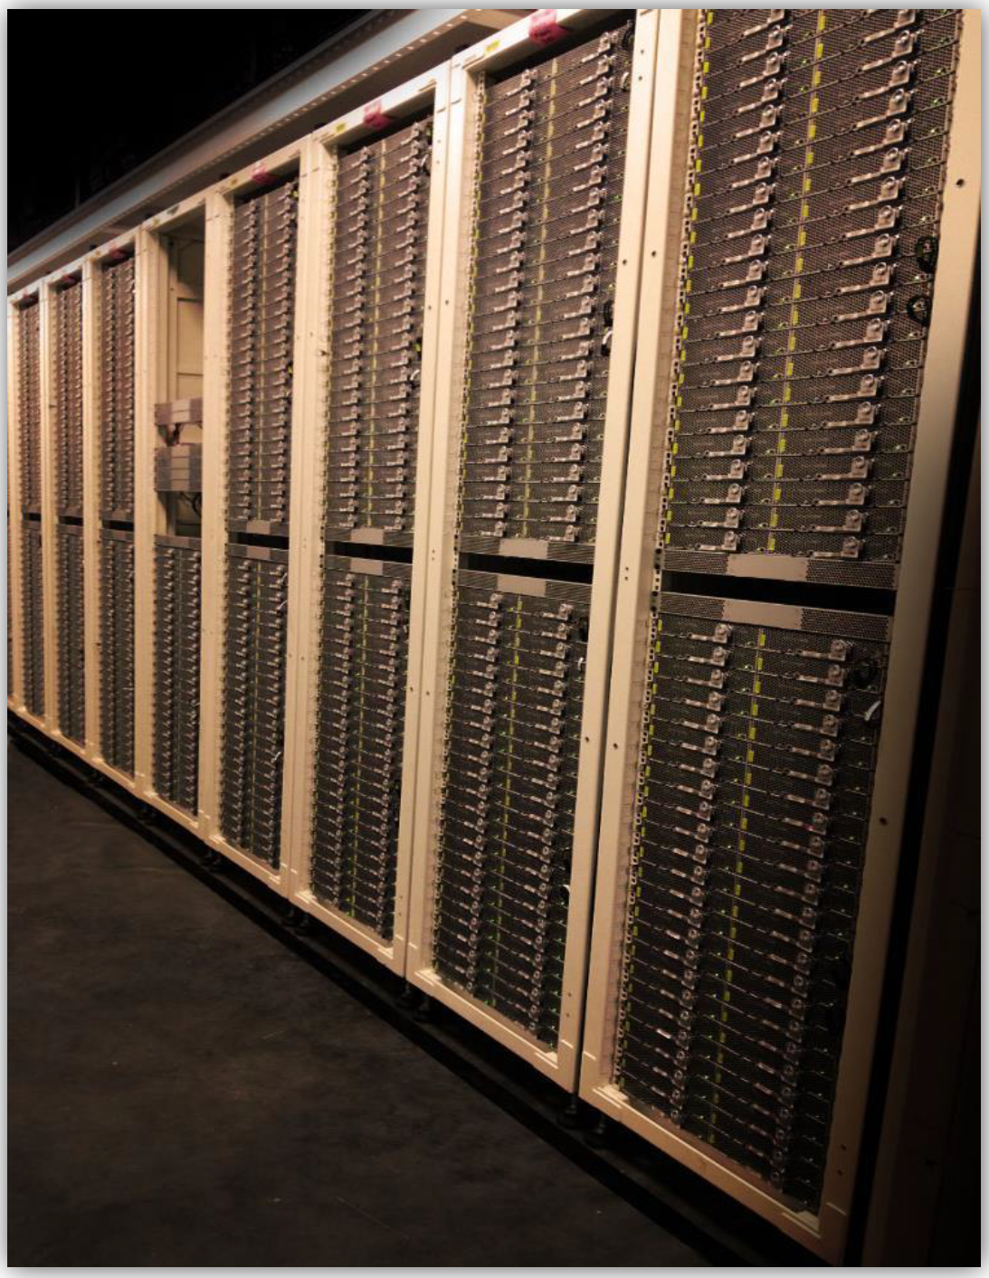


Microsoft Catapult: FPGA for Deep Learning
Bing search engine runs on FPGA-based server
Notes:
Microsoft first developed their own hardware implementation on FPGA for their Bing search engine.
Then, they extended their FPGA solution to cover CNN as these articles show.

Slide 39
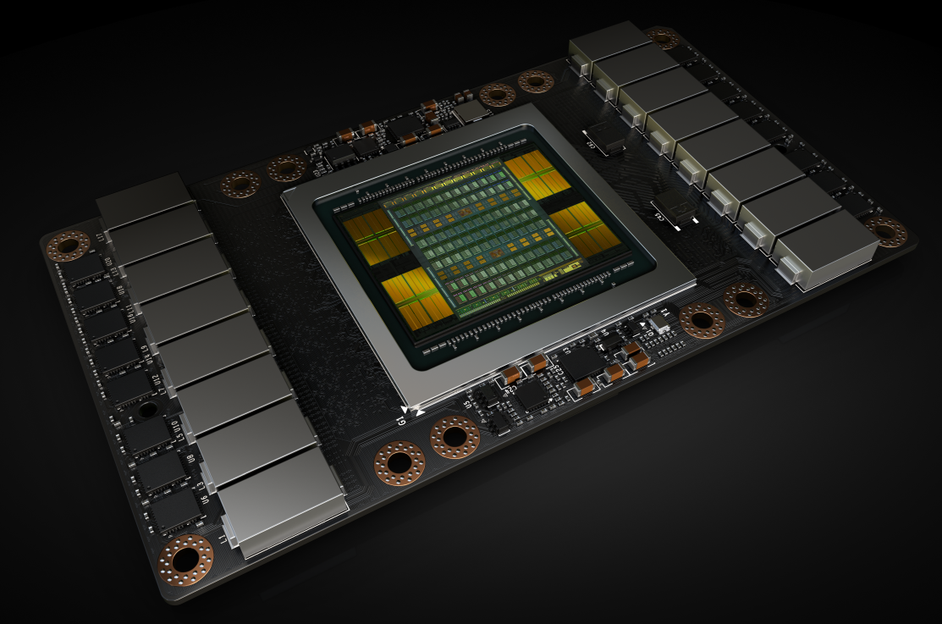
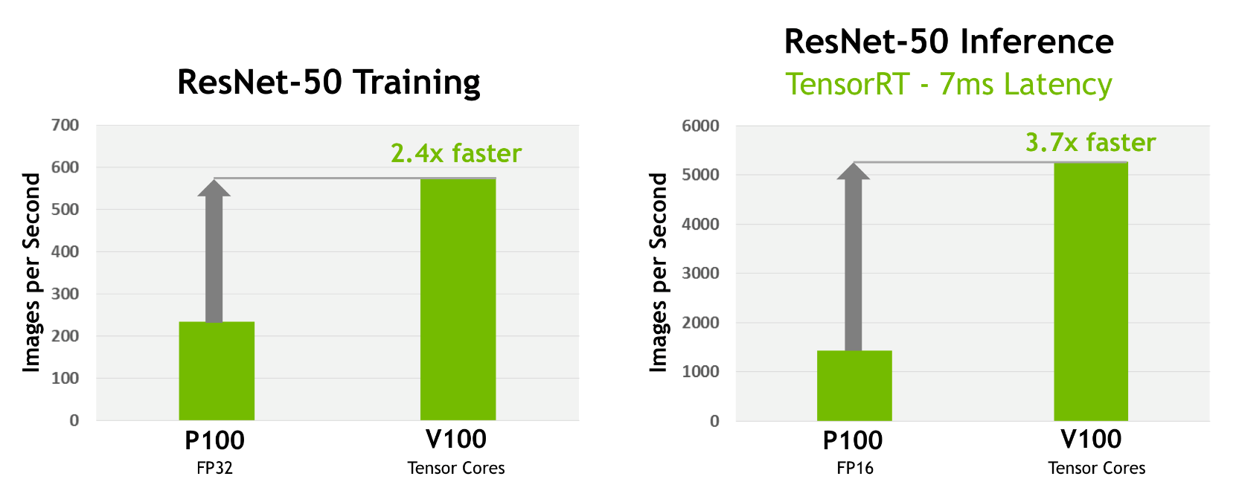
NVIDIA Volta GPU
[https://devblogs.nvidia.com/parallelforall/inside-volta/]
Volta GPU, e.g., V100
2~4X faster than Pascal GPU, e.g., P100 for ResNet
Mainly due to Tensor core
Notes:
NVIDIA started to insert into their GPU a hardware accelerator called Tensor Core for neural network execution in fast and low-power manner.

Slide 40
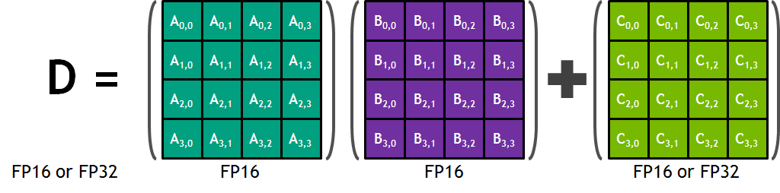
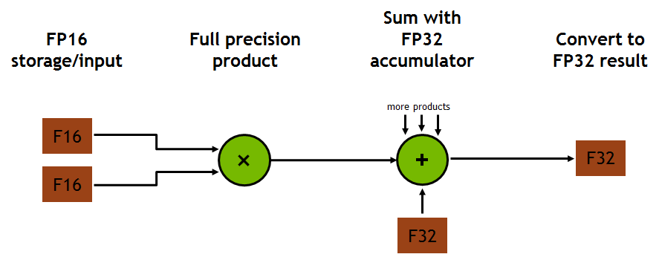
Tensor Core for 4x4 Fused Multiply Add (FMA)
[https://devblogs.nvidia.com/parallelforall/inside-volta/]
Notes:
Tensor core of NVIDIA basically performs 4x4 matrix multiplication and accumulation as this slide shows.
Note that Tensor Core runs 64 16b multiplications, required for this, in parallel. Thus,
64 multiplications finishes in a single clock cycle.
In order to do multiplications with large input matrices, they apply the blocking we briefly touched in the class introduction.

Slide 41
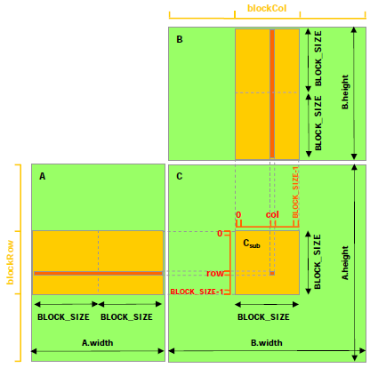
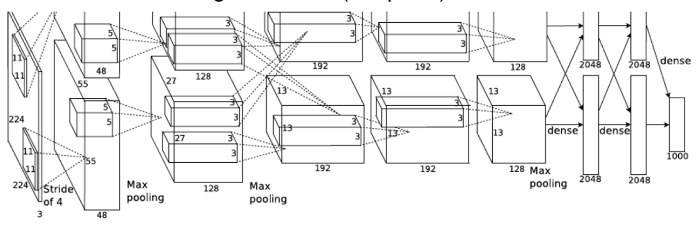
Data Size in Matrix Multiplication
Example: 2nd convolutional layer on AlexNet
Input size = 55x55x48x4B = 580KB
Input matrix size = 580KBx5x5 = 14.5MB
Output size = 27x27x128x4B = 387KB
Kernel size = 48x5x5x128x4B = 614KB
14.5MB
614KB
387KB
Notes:
This slide exemplifies the input and output matrices in the 2nd convolution layer of AlexNet.
We need to multiply an input matrix of 14.5MB and a kernel matrix of 614KB to obtain an output matrix of 387KB.

Slide 42
Blocking to Exploit Small On-Chip Memory
[CUDA Programming Guide, v7.5]
Divide matrix multiplication into small ones
For each small matrix multiplication, input data are reused multiple times
Typically, blocking targets scratch pad memory (e.g., shared memory on NVIDA SM)
CUDA C Programming Guide v7.5
Check the example in FIGURE 10 of “3.2.3 Shared Memory”
Notes:
As we know, blocking is to divide the input matrices and output matrix into smaller sub-matrices and
perform multiplication on those sub-matrices.

Slide 43
Tensor Core for Blocking
[https://devblogs.nvidia.com/parallelforall/inside-volta/]
Notes:
When we use Tensor Core which does 4x4 matrix multiplication and accumulation,
We can divide the input and output matrices into 4x4 sub-matrices and let Tensor Cores perform 4x4 matrix multiplications and accumulations on them.

Slide 44
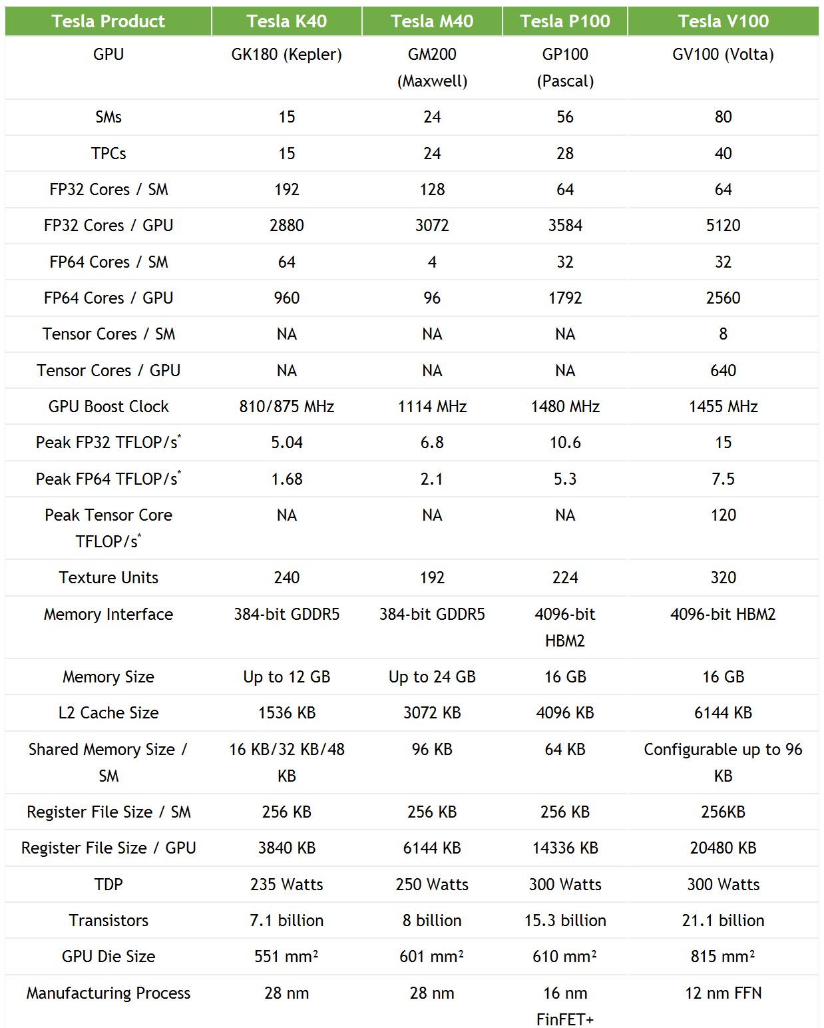
Tesla V100 Tensor Core
[https://devblogs.nvidia.com/parallelforall/inside-volta/]
HW accelerator for 4x4 matrix multiplication and addition
Tensor core
64 multipliers (fp16) + adders (fp32)
8 Tensor cores per SM
8*64 = 512 fp16 multipliers
640 tensor cores on 80 SMs
640*64*1.455GHz*2 (MAC) = 120 TFLOPS
4X more compute power than FP32 cores
64 FP32 cores / SM * 2 (fp16) = 128 vs 512
In reality, more speedup than 4X due to no cache miss, …
Notes:
NVIDIA’s Tesla V100 GPU has 640 tensor cores.
Thus, tensor cores offer a compute capability of 120 Tera Flops (=640 Tensor Cores x 64 multiplications / Tensor Core x 1.455GHz x 2).
Note that we count 2 operations for multiplication and accumulation (addition).
That’s why we use a factor of 2 in the above equation.
Note that V100 GPU has traditional GPU cores to run CUDA code as well as Tensor Cores dedicated to matrix multiplication.

Slide 45
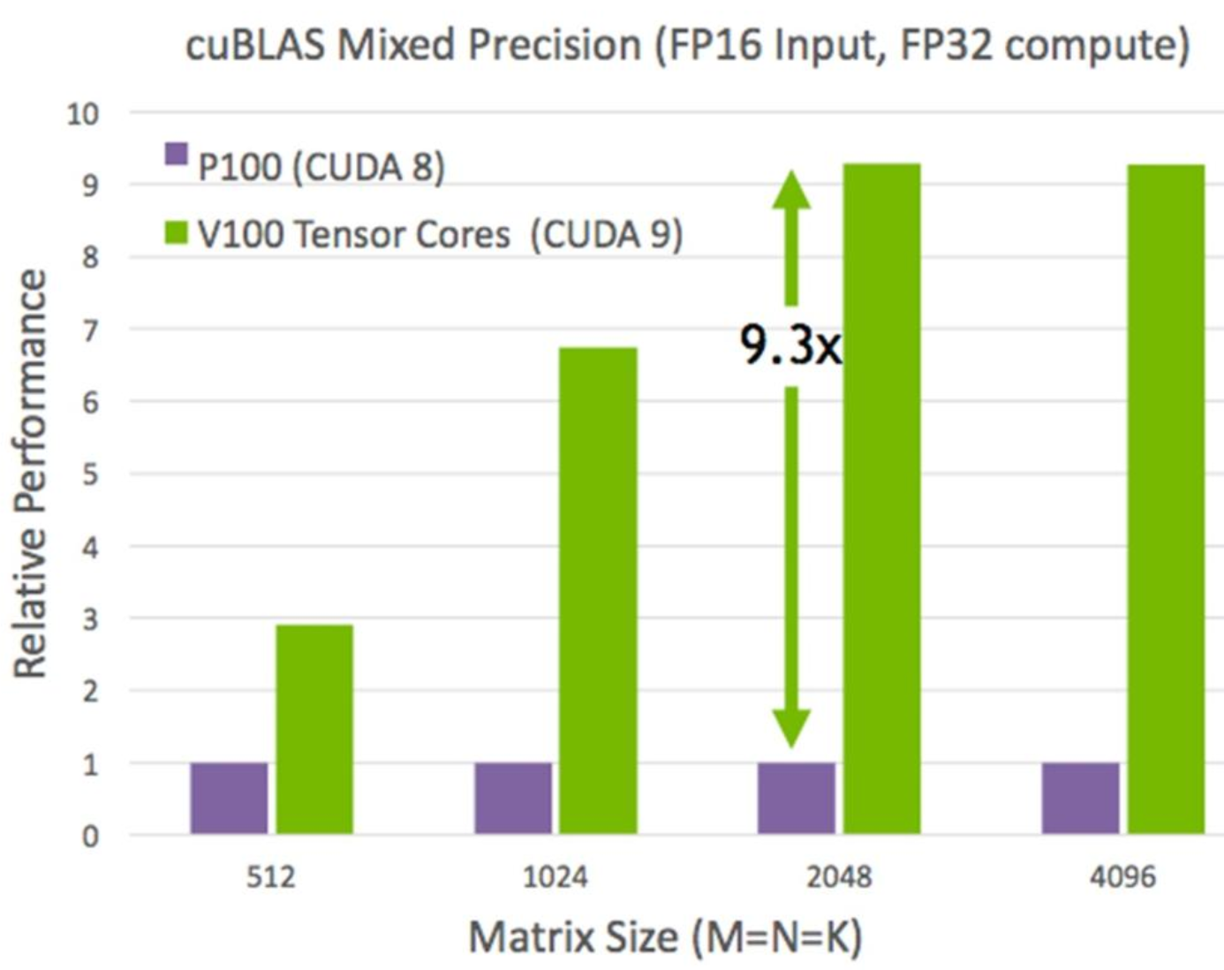

Results
[https://devblogs.nvidia.com/parallelforall/inside-volta/]
9X speedup for matrix multiplication
Amdahl’s law
<9X speedup for system performance
Notes:
Compared with the previous NVIDIA GPUs like P100, Tensor cores offer significant performance boost to V100 as this slide shows.

Slide 46
Lecture Agenda
Introduction
What happens in human primary visual cortex (V1)?
Basics of neural network
Multi-layer perceptron (MLP)
Convolution
Recent hardware designs for neural networks
Google TPU, Microsoft, NVIDIA
Our project
FPGA-based matrix multiplication for MLP and CNN
Notes:
Let’s try to have more understanding on our project to implement matrix multiplication for MLP and CNN (via convolution lowering) on FPGA.

Slide 47
Matrix*Vector Multiplication in MLP
Each layer (1024 inputs and 256 outputs) performs 1024 multiplications between 1024 inputs and associated weights (W) to give an output
Each layer performs M*V multiplication to give 256 outputs
Output[0] = Σ_{j} Input[j]*W[0,j]
W[0][0]
W[0][1]
W[0][2]
W[0][1023]
Input[0]
Output[1] = Σ_{j} Input[j]*W[1,j]
W[1][0]
W[1][1]
W[1][2]
W[1][1023]
Input[1]
Output[2] = Σ_{j} Input[j]*W[2,j]
W[2][0]
W[2][1]
W[2][2]
W[2][1023]
Input[2]
Output[255] = Σ_{j} Input[j]*W[N-1,j]
W[255][0]
W[255][1023]
Input[1023]
Notes:
As we know, MV multiplication is needed for MLP.
In our case, we implement MM multiplication with a series of MV multiplications.
Thus, our basic building block is MV multiplication.
In our FPGA implementation, we will design MV multiplication function in hardware.

Slide 48
Hardware (MV Accelerator) Design
Baseline Accelerator
It computes multiple row*vector multiplications in parallel
Blocking is typically applied
Call overhead of blocking function
Initialization of software/hardware communication can take more time than a single data transfer
Call overhead can be reduced by increasing the block size which
Reduces # calls to the blocking function
Increases the amount of input/output data per function call
X0XX0X0X
Vec
Matrix
PE0
X0XX0XX
0X00X0X
PE1
Notes:
Our hardware design, MV multiplication accelerator, in short MV accelerator looks like this figure.
PE (processing element) consists of multiplier and accumulator (with adder) called MAC.
In this simple example, we run two PEs in parallel.
To do that, we provide them with input data (matrix weights and vector element).
Note that the same vector element is broadcast to the two PEs.
After performing two multiplications in parallel,
We provide the two PEs with the next set of data.
As we know, each PE actually does a dot product operation between a row of weight matrix and the input vector.
We do blocking. That is, we divide our input and output matrices into blocks and do block-level multiplications.
In case of software only implementation, calling a block-level multiplication does not incur a significant overhead, but a typical function call overhead. However, when we use our own MV accelerator and we run it inside of the block-level multiplication,
Calling the hardware accelerator, or calling the blocked multiplication function (in short, blocking function) can be significant
Since CPU to hardware communication takes long time.
Thus, it is important to minimize the number of blocking function calls.
In our practice of Week 1, we do blocking for software only implementation.
However, since we will use our software code later to integrate our MV accelerator,
We do blocking while minimizing the number of blocking function calls.

Slide 49
Block-based Matrix-Vector Multiplication Example
Block size is typically determined by memory size and # compute units in processing elements (PEs)
Matrix (M)
Vector (V)
PE1
PE2
a
b
1
c
d
5
x
x
+
+
Accumulator
Accumulator
Notes:
Let’s see how we apply blocking to MV multiplication in this example.
We do 4x4 matrix by 4-dim vector using two PEs.
First, we can have a block of 2x2 on the weight matrix as this slide shows.
In this case, we may need to call block-based MV multiplication four times to finish the MV multiplication.
Assuming a single clock cycle on multiply and accumulate operation, a single blocking function takes two clock cycles doing two multiplications two times, and the total runtime will be 8 (=2 cycles/block x 4 blocks) clock cycles when ignoring software-hardware communication latency.
See the following four slides to see how blocking works in this example.

Slide 50
Block-based Matrix-Vector Multiplication Example
1st clock cycle: Broadcast ‘1’ to two PEs and each PE multiplies the broadcast vector element by its own weight
Matrix (M)
Vector (V)
a
b
1
a
1
c
1
c
d
5
x
x
+
+
Accumulator
Accumulator
Notes:
A block by sub-vector multiplication takes 2 cycles.
This slides shows the first cycle of the two cycles.
The vector element ‘1’ is broadcast to the two PEs.
Each PE receives its own kernel weight, a for PE1, and c for PE2.
Each PE multiplies the two input and accumulates the result with the current contents of accumulator register.

Slide 51
Block-based Matrix-Vector Multiplication Example
2nd clock cycle: Broadcast ‘5’ to two PEs and each PE multiplies the broadcast vector element by its own weight
Matrix (M)
Vector (V)
a
b
1
b
5
d
5
c
d
5
x
x
+
+
Accumulator
Accumulator
Notes:
In the second cycle of the first block, the second vector element ‘5’ is broadcast to the two PEs.
Each PE receives its own weight, PE1 receives b and PE2 d.
Each PE multiplies the two inputs and accumulates the result with the current contents of accumulator register.

Slide 52
Block-based Matrix-Vector Multiplication Example
3rd clock cycle: Move to the next block and do the same work
Matrix (M)
Vector (V)
a
b
e
f
1
e
3
g
3
c
d
g
h
5
x
x
3
+
+
2
Accumulator
Accumulator
Notes:
This slide shows the first clock cycle of the second block multiplication.

Slide 53
Block-based Matrix-Vector Multiplication Example
4th clock cycle: Two PEs produce two elements of output vector
Matrix (M)
Vector (V)
a
b
e
f
1
O1
f
2
h
2
c
d
g
h
5
O2
x
x
3
+
+
2
Accumulator
Accumulator
O1
O2
Notes:
After finishing the second block multiplication, each PE has an element of output matrix, .e.g, PE1 has O1 as the output.

Slide 54
Block-based Matrix-Vector Multiplication Example
Large PE memory enables larger block thereby improving communication, e.g., amortizing the overhead of function call
Matrix (M)
Vector (V)
PE1
PE2
a
b
e
f
1
c
d
g
h
5
x
x
3
+
+
2
Accumulator
Accumulator
Notes:
If we can have a larger block like 2x4 shown in this slide,
We have only to call the blocking function two times.
Each blocking function will take four clock cycles and the total runtime will be 8 clock cycles.
When we ignore software-hardware communication,
The two cases have the same cycles.
However, if software-hardware communication is considered and large, e.g., 2 clock cycles,
The second case, where we have fewer blocking function calls, can finish earlier than the first case.
Note that in the two cases (previous and current ones), we still use only two PEs.
However, we assume two cases, 2x2 block and 2x4 block.
Block size for hardware accelerator is typically determined by the memory size on the hardware accelerator.
Thus, in order to reduce the number of blocking function calls, i.e., software-hardware communication overhead,
It is important to have as large memory as possible on the accelerator side.

Slide 55
Block-based Matrix-Vector Multiplication Example
Larger block (larger PE memory and more compute units) can further improve performance
Matrix (M)
Vector (V)
PE1
PE2
PE3
PE4
a
b
e
f
1
c
d
g
h
5
x
x
x
x
i
j
3
+
+
+
+
k
l
2
Accumulator
Accumulator
Accumulator
Accumulator
Notes:
In this example, we have 2x more Pes than the previous case.
Thus, we can reduce the cycles spent for computation.
However, the call overhead of blocking function does not change since it depends on the number of function calls, not the number of PEs.

Slide 56
Blocking Code Example
[NVIDIA][http://www.cs.cornell.edu/~bindel/class/cs5220-s10/slides/lec03.pdf]
M*V multiplication case
Size of V (=M) = 1024
Size of output (=N) = 256
Block size (bs) = 2x2
Two multipliers run in parallel
W[0][0]
W[0][1]
W[0][2]
W[0][M-1]
Input[0]
Output[0]
W[1][0]
W[1][1]
W[1][2]
W[1][M-1]
Input[1]
Output[1]
W[2][0]
W[2][1]
W[2][2]
W[2][M-1]
Input[2]
Output[2]
W[N-1][0]
W[N-1][M-1]
Input[M-1]
Output[N-1]
Output[i] = Σ_{j} Input[j]*W[i,j]
j=0
for(j=0; j<M; j++) {
for(i=0; i<N; i++)
Output[i] += Input[j]*W[i,j];
}
for(j=0; j<M; j+=2) {
for(i=0; i<N; i+=2) {
Output[i] += Input[j]*W[i,j] + Input[j+1]*W[i,j+1];
Output[i+1] += Input[j]*W[i+1,j] + Input[j+1]*W[i+1,j+1];
}
}
i=0
Before blocking
After blocking
Notes:
This slides shows blocking example and C code for the blocking.
On the lower left corner, we have C code for matrix vector multiplication.
We assume 2x2 block as shown in the upper right corner.
The code on the lower right shows the blocking code.
There are two key changes compared with the original code.
First the red dashed box has two lines of code, each for one output.
Actually, a line here corresponds to the PE operation in the previous MV accelerator example.
Thus, we can assume we can implement this code section (red rectangle) with a MV accelerator with two PEs.
The second difference, compared with the original code, is that the indices i and j increases by 2 because we use 2x2 block.
In other words, the index increase by a slide K when use use KxK block.
This slide shows the case that index i = 0.

Slide 57
Blocking Code Example
[NVIDIA][http://www.cs.cornell.edu/~bindel/class/cs5220-s10/slides/lec03.pdf]
M*V multiplication case
Size of V (=M) = 1024
Size of output (=N) = 256
Block size (bs) = 2x2
W[0][0]
W[0][1]
W[0][2]
W[0][M-1]
Input[0]
Output[0]
W[1][0]
W[1][1]
W[1][2]
W[1][M-1]
Input[1]
Output[1]
W[2][0]
W[2][1]
W[2][2]
W[2][M-1]
Input[2]
Output[2]
W[N-1][0]
W[N-1][M-1]
Input[M-1]
Output[N-1]
Output[i] = Σ_{j} Input[j]*W[i,j]
j=0
for(j=0; j<M; j++) {
for(i=0; i<N; i++)
Output[i] += Input[j]*W[i,j];
}
for(j=0; j<M; j+=2) {
for(i=0; i<N; i+=2) {
Output[i] += Input[j]*W[i,j] + Input[j+1]*W[i,j+1];
Output[i+1] += Input[j]*W[i+1,j] + Input[j+1]*W[i+1,j+1];
}
}
i=2
Before blocking
After blocking
Notes:
This slide shows the case that index i = 2.
Note that the 2x2 block on the upper right moved downward by 2 positions.
The output region also moved in the same manner as the other dashed rectangle on the output vector shows.
Note also that the input block is the same.

Slide 58
Blocking Code Example
[NVIDIA][http://www.cs.cornell.edu/~bindel/class/cs5220-s10/slides/lec03.pdf]
M*V multiplication case
Size of V (=M) = 1024
Size of output (=N) = 256
Block size (bs) = 2x2
W[0][0]
W[0][1]
W[0][2]
W[0][M-1]
Input[0]
Output[0]
W[1][0]
W[1][1]
W[1][2]
W[1][M-1]
Input[1]
Output[1]
W[2][0]
W[2][1]
W[2][2]
W[2][M-1]
Input[2]
Output[2]
W[N-1][0]
W[N-1][M-1]
Input[M-1]
Output[N-1]
Output[i] = Σ_{j} Input[j]*W[i,j]
Note: Input[0] and Input[1] are reused
saving communication overhead
j=0
for(j=0; j<M; j++) {
for(i=0; i<N; i++)
Output[i] += Input[j]*W[i,j];
}
for(j=0; j<M; j+=2) {
for(i=0; i<N; i+=2) {
Output[i] += Input[j]*W[i,j] + Input[j+1]*W[i,j+1];
Output[i+1] += Input[j]*W[i+1,j] + Input[j+1]*W[i+1,j+1];
}
}
i=N-2
Before blocking
After blocking
Notes:
Here, we finally arrived at index i = N-2.
In upper right corner, we see we finished covering the first two columns of weight matrix.
Note that, we used the same input until now.

Slide 59
Blocking Code Example
[NVIDIA][http://www.cs.cornell.edu/~bindel/class/cs5220-s10/slides/lec03.pdf]
M*V multiplication case
Size of V (=M) = 1024
Size of output (=N) = 256
Block size (bs) = 2x2
W[0][0]
W[0][1]
W[0][2]
W[0][M-1]
Input[0]
Output[0]
W[1][0]
W[1][1]
W[1][2]
W[1][M-1]
Input[1]
Output[1]
W[2][0]
W[2][1]
W[2][2]
W[2][M-1]
Input[2]
Output[2]
W[N-1][0]
W[N-1][M-1]
Input[M-1]
Output[N-1]
Output[i] = Σ_{j} Input[j]*W[i,j]
j=2
for(j=0; j<M; j++) {
for(i=0; i<N; i++)
Output[i] += Input[j]*W[i,j];
}
for(j=0; j<M; j+=2) {
for(i=0; i<N; i+=2) {
Output[i] += Input[j]*W[i,j] + Input[j+1]*W[i,j+1];
Output[i+1] += Input[j]*W[i+1,j] + Input[j+1]*W[i+1,j+1];
}
}
i=0
Before blocking
After blocking
Notes:
Now, index j = 2.
The vector block now moved downward by 2 positions.
Note that the 2x2 block also moved to the right while the output sub-vector starts from the initial position.

Slide 60
Blocking Code Example
[NVIDIA][http://www.cs.cornell.edu/~bindel/class/cs5220-s10/slides/lec03.pdf]
M*V multiplication case
Size of V (=M) = 1024
Size of output (=N) = 256
Block size (bs) = 2x2
W[0][0]
W[0][1]
W[0][2]
W[0][M-1]
Input[0]
Output[0]
W[1][0]
W[1][1]
W[1][2]
W[1][M-1]
Input[1]
Output[1]
W[2][0]
W[2][1]
W[2][2]
W[2][M-1]
Input[2]
Output[2]
W[N-1][0]
W[N-1][M-1]
Input[M-1]
Output[N-1]
Output[i] = Σ_{j} Input[j]*W[i,j]
j=2
for(j=0; j<M; j++) {
for(i=0; i<N; i++)
Output[i] += Input[j]*W[i,j];
}
for(j=0; j<M; j+=2) {
for(i=0; i<N; i+=2) {
Output[i] += Input[j]*W[i,j] + Input[j+1]*W[i,j+1];
Output[i+1] += Input[j]*W[i+1,j] + Input[j+1]*W[i+1,j+1];
}
}
i=2
Before blocking
After blocking
Notes:
Then, we increment index i by 2 to go downward as before.

Slide 61
Blocking Code Example
[NVIDIA][http://www.cs.cornell.edu/~bindel/class/cs5220-s10/slides/lec03.pdf]
M*V multiplication case
Size of V (=M) = 1024
Size of output (=N) = 256
Block size (bs) = 2x2
W[0][0]
W[0][1]
W[0][2]
W[0][M-1]
Input[0]
Output[0]
W[1][0]
W[1][1]
W[1][2]
W[1][M-1]
Input[1]
Output[1]
W[2][0]
W[2][1]
W[2][2]
W[2][M-1]
Input[2]
Output[2]
W[N-1][0]
W[N-1][M-1]
Input[M-1]
Output[N-1]
Output[i] = Σ_{j} Input[j]*W[i,j]
Note: Input[2] and Input[3] are reused!
j=2
for(j=0; j<M; j++) {
for(i=0; i<N; i++)
Output[i] += Input[j]*W[i,j];
}
for(j=0; j<M; j+=2) {
for(i=0; i<N; i+=2) {
Output[i] += Input[j]*W[i,j] + Input[j+1]*W[i,j+1];
Output[i+1] += Input[j]*W[i+1,j] + Input[j+1]*W[i+1,j+1];
}
}
i=N-2
Before blocking
After blocking
Notes:
The slides shows the end of iteration when j = 2.

Slide 62
Software/Hardware Partitioning
MLP is our application
Each layer is matrix-vector multiplication, e.g., 256x1024 matrix * 1024-d vector ➔ 256-d vector
ARM CPU runs the main function which calls your MV IP on PL
MV for 64x64 weight matrix * 64-entry input vector multiplication
BRAM is used for data transfer between SW and HW
Xilinx Zynq (XC7Z020)
One layer in MLP (Software running on CPU)
Processing System
(PS, ARM Co-A9)
Programmable Logic
(PL, Xilinx Artix-7)
for(j=0; j<1024; j+=8) {
for(i=0; i<256; i+=8) {
Output[i] += Input[j]*W[i,j] + Input[j+1]*W[i,j+1] + …
Output[i+1] += Input[j]*W[i+1,j] + Input[j+1]*W[i+1,j+1] + …
…
Output[i+7] += Input[j]*W[i+7,j] + Input[j+1]*W[i+7,j+1] + …
}
}
Core #1
MV function on Hardware
Matrix-Vector Multiplication Custom IP
Core #2
Memory interface
AXI master
BRAM
Notes:
As we covered in the class introduction with this slide,
We use Xilinx Zynq FPGA.
We will implement the software part of our CNN on the ARM processor and
Our MV accelerator on the programmable logic part.
Specifically, we will replace the code of block-based multiplication (block dashed rectangle on the left)
With a function call to our MV accelerator in the programmable logic.
In order to provide the MV accelerator with the input data, and to receive the result of MV accelerator,
We use a memory module called BRAM as shown in the figure.

Slide 63

Block Data and Command in SW-HW Communication
Input / Output Block
Command
Notes:
This is the schematic diagram of our design.
You will design the entire system using a graphic user interface like this.
In this example, if you check the name of each module, we can see that this schematics include both software (processing_system), bus (axi_mem_interconnect), accelerator (myip) and memory for software-hardware communication (bram_ctrl and blk_mem).

Slide 64
Lecture Summary
How can simple matrix multiplication outperform human?
Human neural system does matrix multiplication
How does the current hardware system run neural networks?
Matrix multiplication and other small functions run on
GPU, dedicated chips or FPGAs, e.g., Google TPU, Microsoft Catapult v2, …
What does our hardware MV do in neural networks?
Accelerating block MV multiplication called by MLP application software
V*V multiplication
Notes:
This is the summary of lecture on Week 1.
Thank you!

Slide 65
Weekly Schedule
W1 17 Application (deep learning on FPGA)/SW app (MNIST/CIFAR)
W2 25 Verilog 1 Basics/Vivado tutorial (verification level of HW design)
W3 4/1 Verilog 2 Combinational circuits (Video pre-view homework + TA Q&A)/Simple adder using dsp (V+V, Verilog intro)
W4 8 Verilog 3 Sequential circuits/V*V processing element (PE) design 1
W5 15 Verilog 4 Design example & synthesizable code/V*V processing element (PE) design 2
W6 22 Intro to Zynq & MV accelerator design/Zynq FPGA & synthesis, continue VV design & start MV accelerator design
W7 29 Mid-term exam/No practice
W8 5/6 Main memory (physical & virtual)/OS+FPGA (HOST~DEVICE) communication & MV design 2
W9 13 Bus and DMA (Video pre-view + TA Q&A)/custom IP & MV design 3
W10 20 Convolution lowering and matrix multiplication accelerator/Convolution lowering (V0)
W11 27 Advanced deep learning #1 quantization for low precision computation/V0+DMA+8b
W12 6/3 Advanced deep learning #2 zero skipping/V0+DMA+8b+zero-skipping 1
W13 10 Lecture summary/V0+DMA+8b+zero-skipping 2
W14 17 Final exam/Term project (V0+DMA+8b+zero) submission

Slide 66
Introduction to this week’s lab
In this semester, we have the following design flow
Software design of our target CNN
MV multiplication is still software implementation
Hardware (Verilog) design of MV accelerator
Software/hardware integration, e.g., calling MV accelerator from your software code
Optimizing software/hardware design
DMA, 32bit to 8bit, zero skipping
Week 1
Software design of our target CNN
Converting a portion of software code (blocking MV multiplication) to a function call (which will execute the hardware MV accelerator after your hardware is ready) while considering the number of function calls.

Slide 67
Summary and Q&A
Before lecture
Send your questions to eTL by 11:59pm, Monday, March 16
After lecture
Upload your 1-page lecture summary in Word file and questions, if any, to eTL

